Slide 1

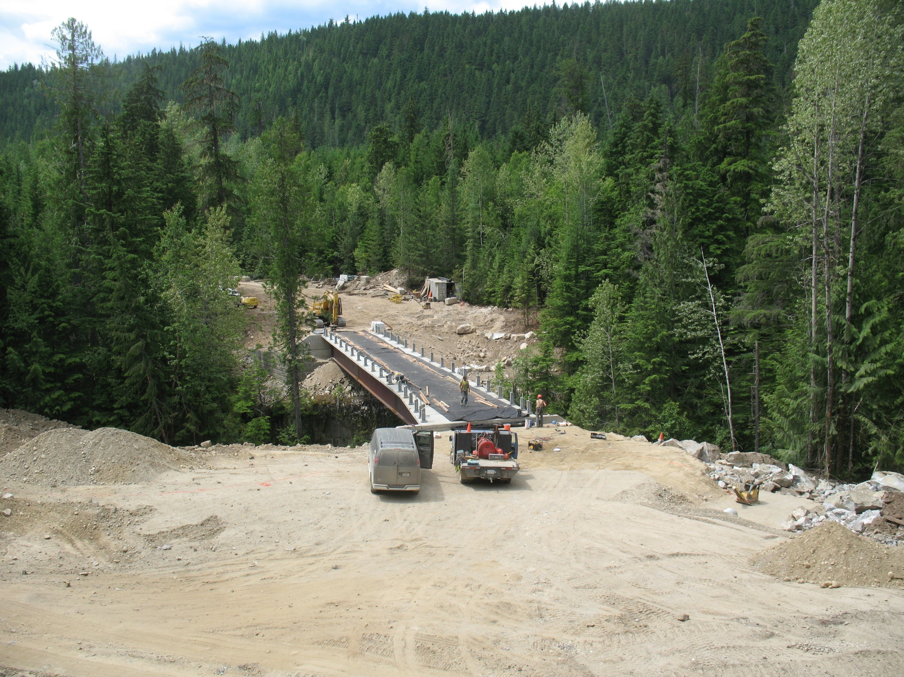
Bridge Contracting Issues:
Common Problems, Lessons Learned and Monitoring

Slide 2
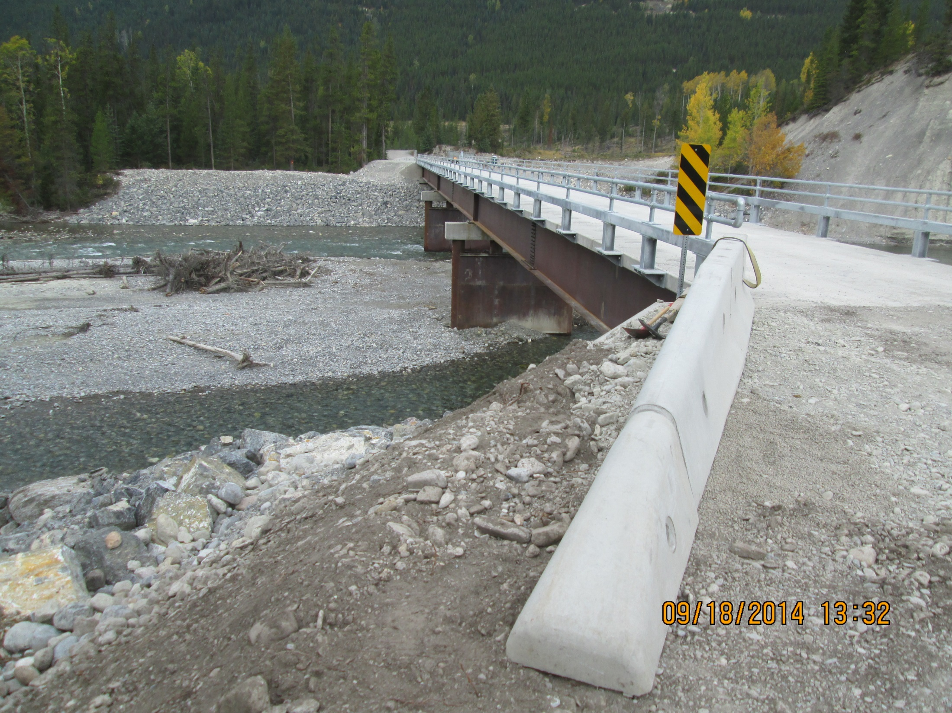
Survey and Layout
Material Supply and Delivery
Footings and Rip Rap
Girder Splice / Turn of Nut
Specification Verification / Testing
Inspection / Monitoring/ Professional of Record

Slide 3
Survey and Layout
Ensure all parameters of area to be surveyed identified
Permanent benchmarks established
Verify General Arrangement vs Structure Drawings
Qualified personnel at layout

Slide 4
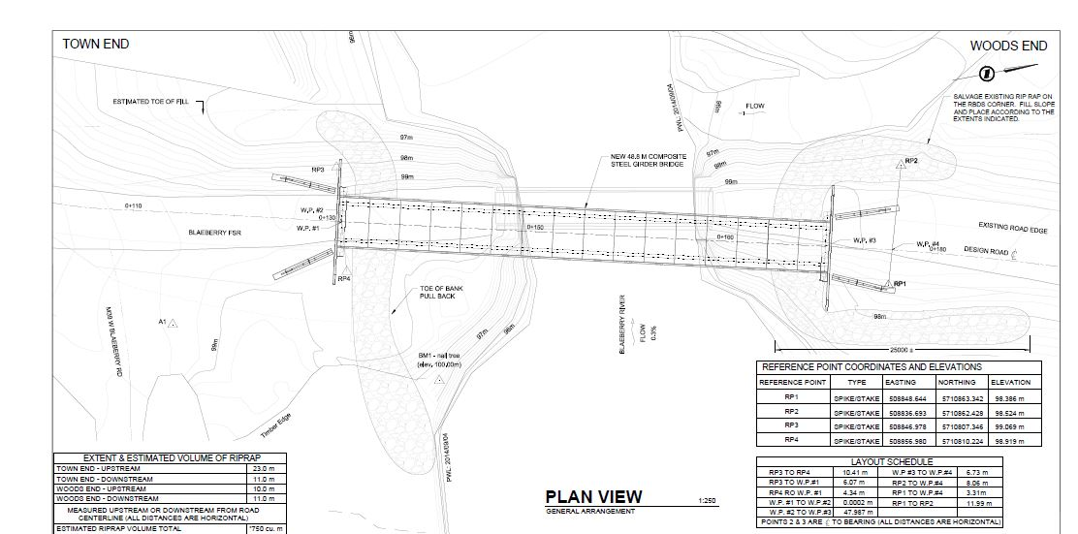
Review General Arrangement Drawing for completeness and survey requirements
Notes:
Benchmarks located in footprint of bridge and road approach so will not be in place once constructed

Slide 5
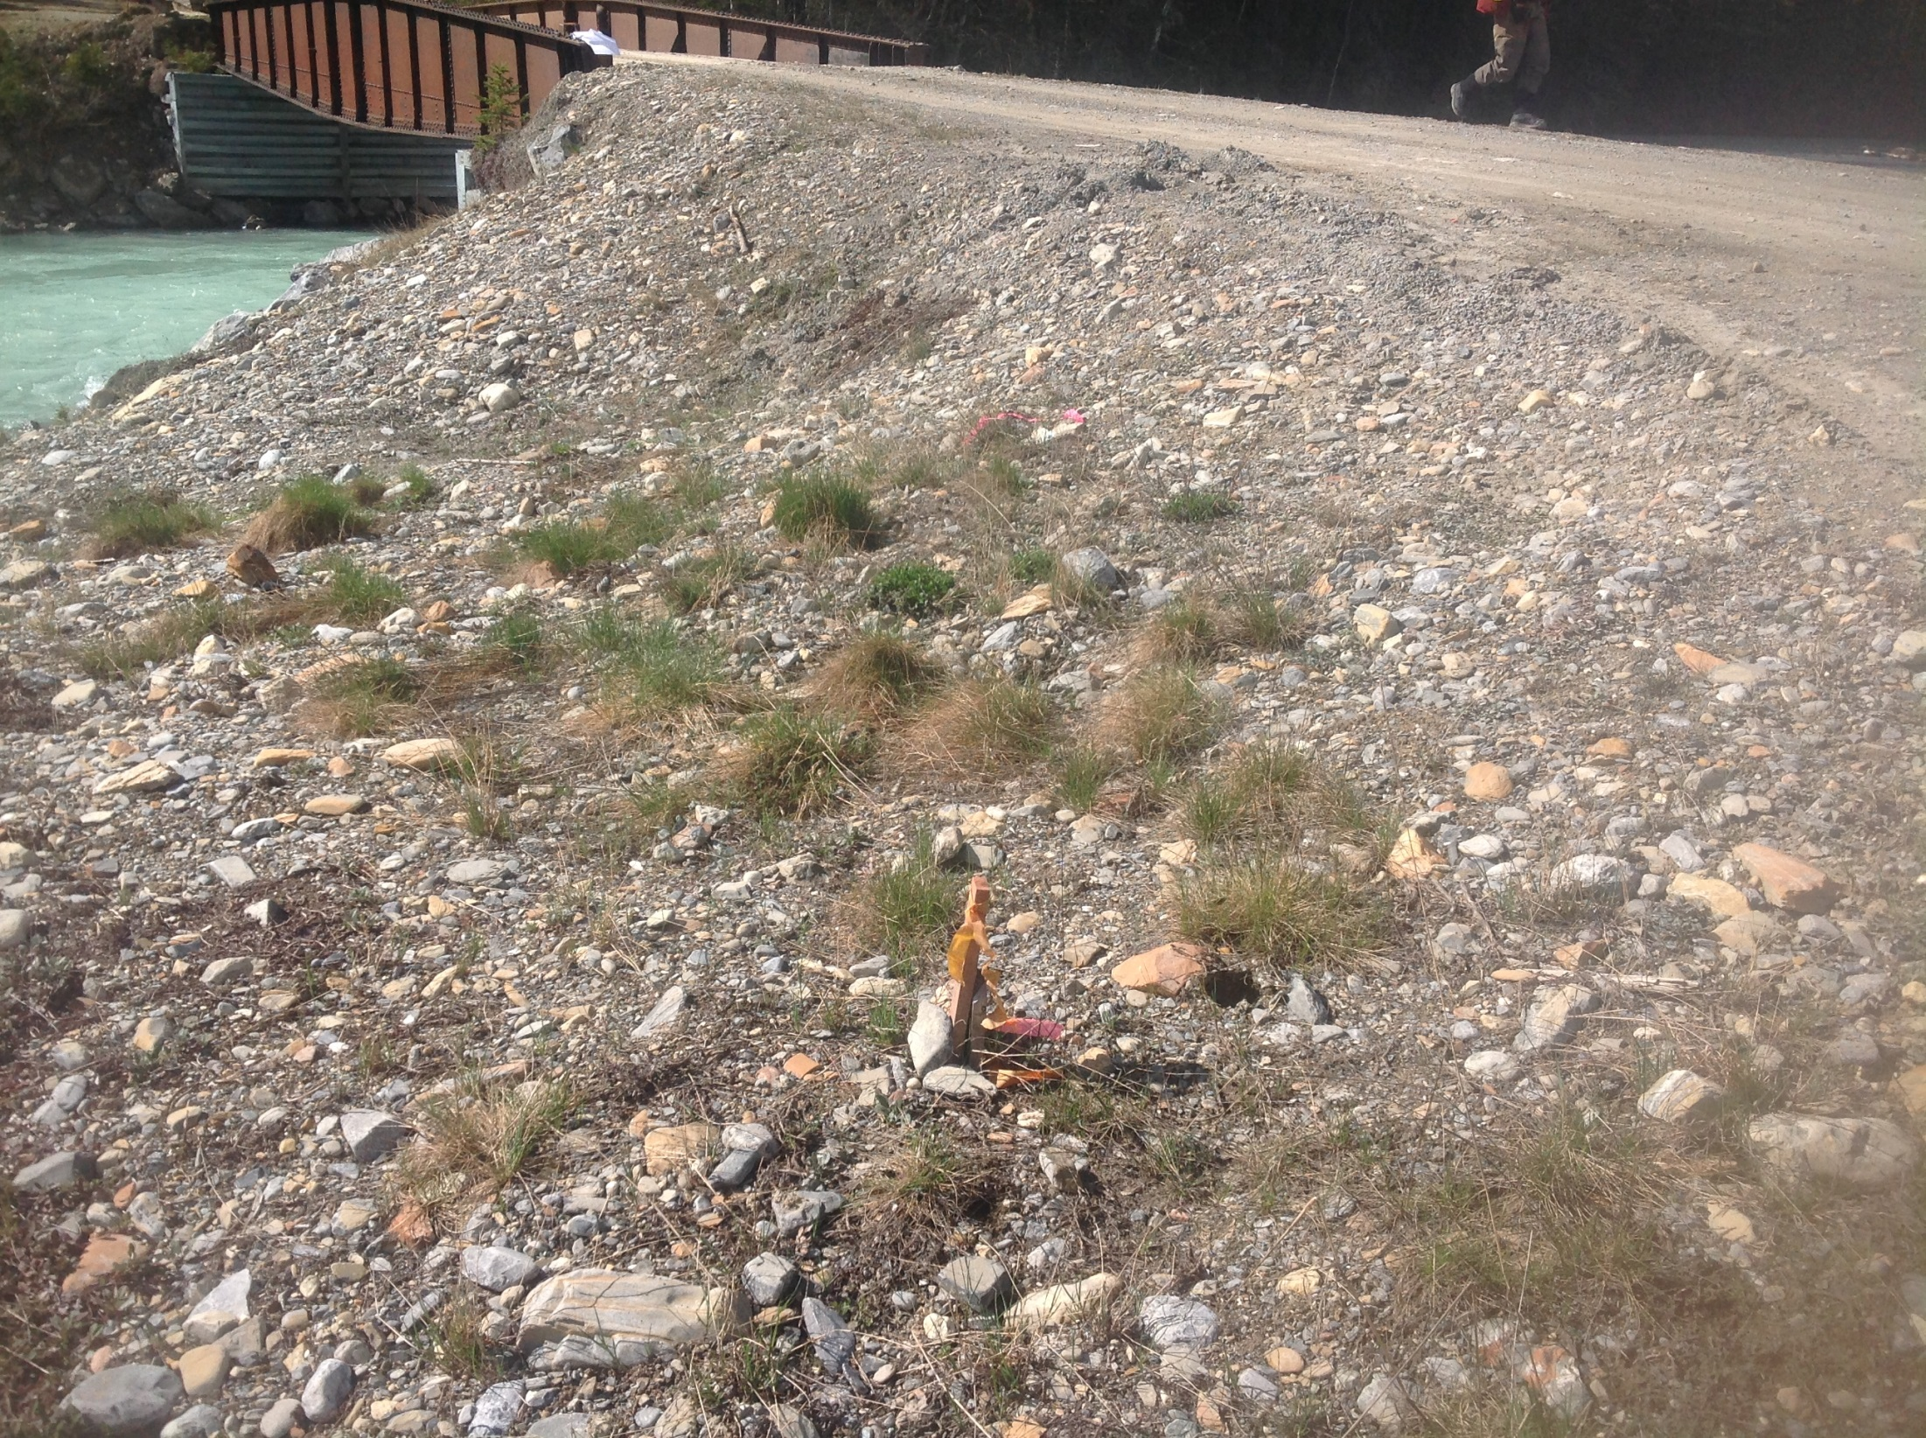

Slide 6
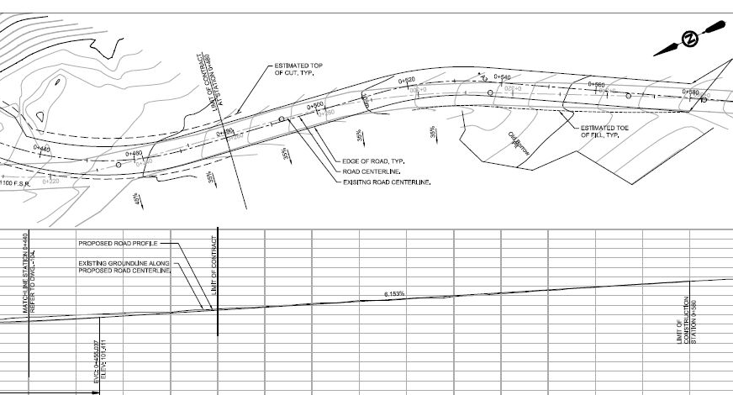
Ensure required extents are gathered
Notes:
Not enough survey information gathered for the road approach design.

Slide 7
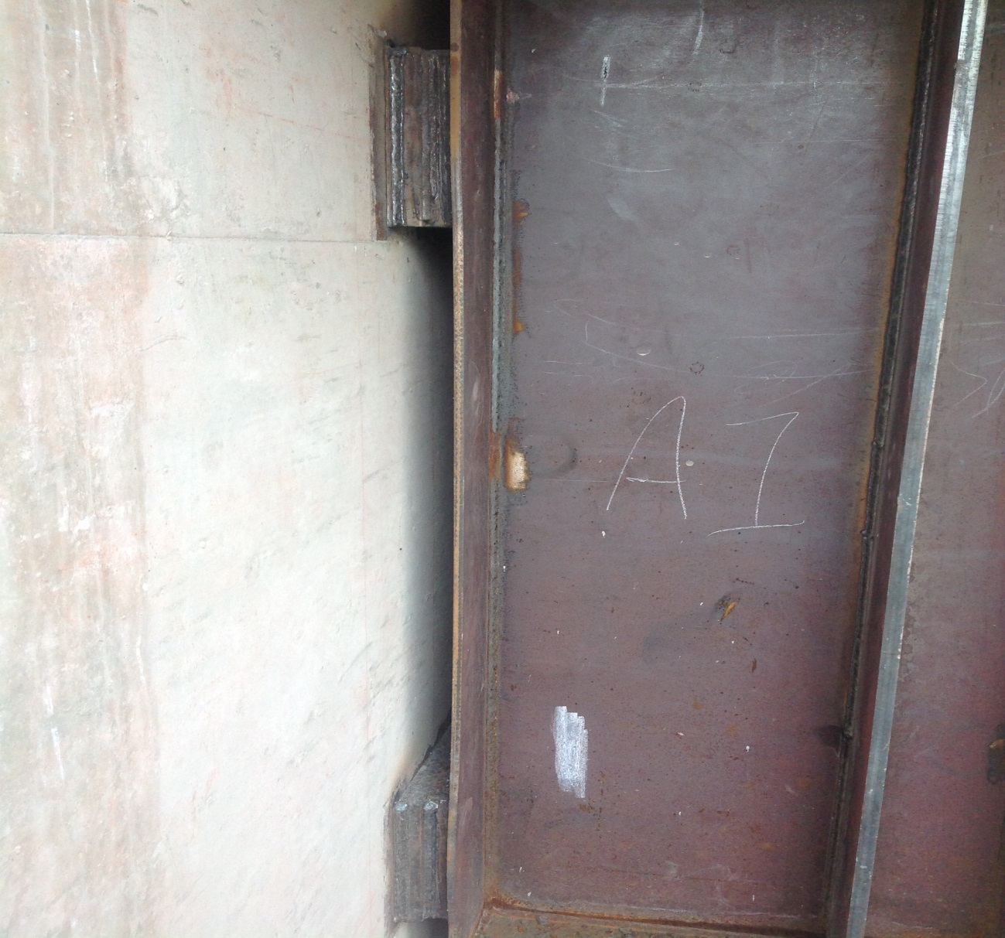
Check Structure Drawings at Layout versus GA Drawings
Notes:
Structure had piles placed according to GA. Structure drawings had slightly different. Needed to add shims between girders and ballast wall. Needed to add extra stiffeners and add extra plate to bottom of pile cap.

Slide 8
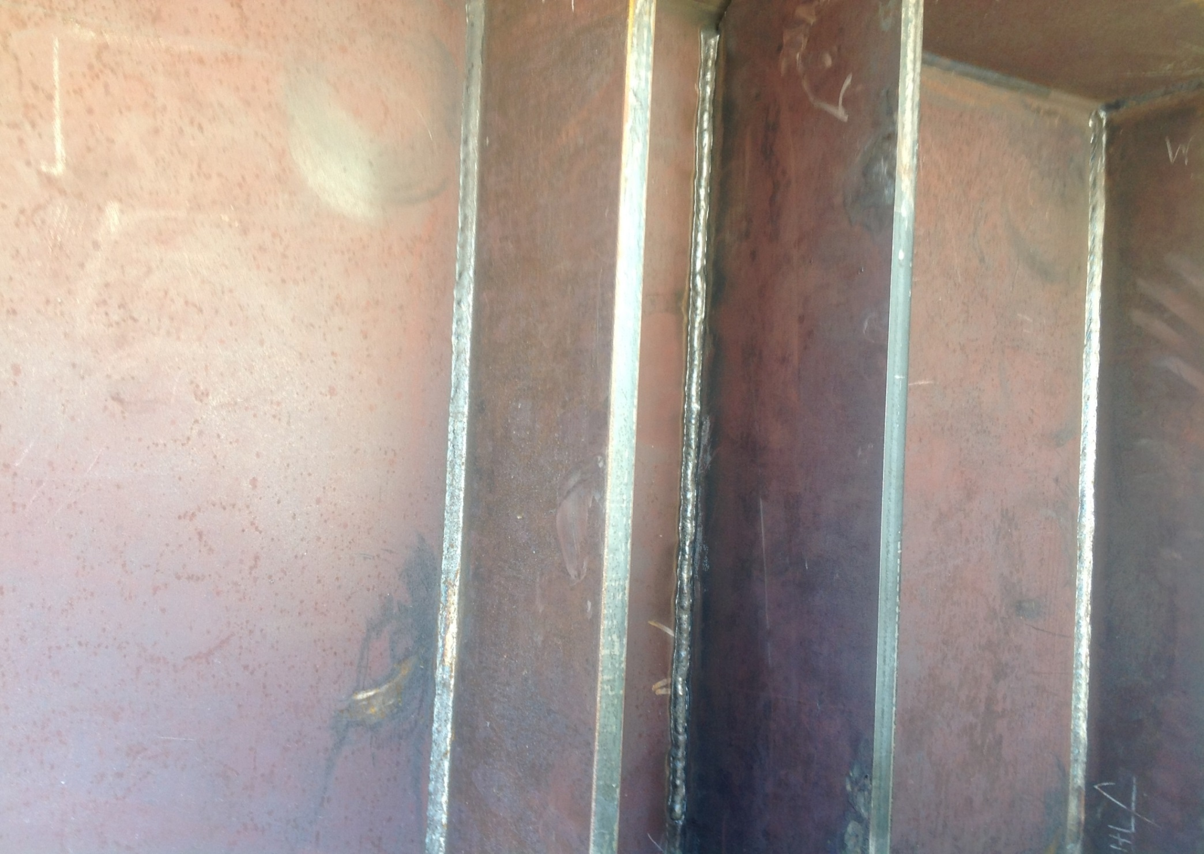
Notes:
Extra stiffener required due to bearing location needing to be changed

Slide 9
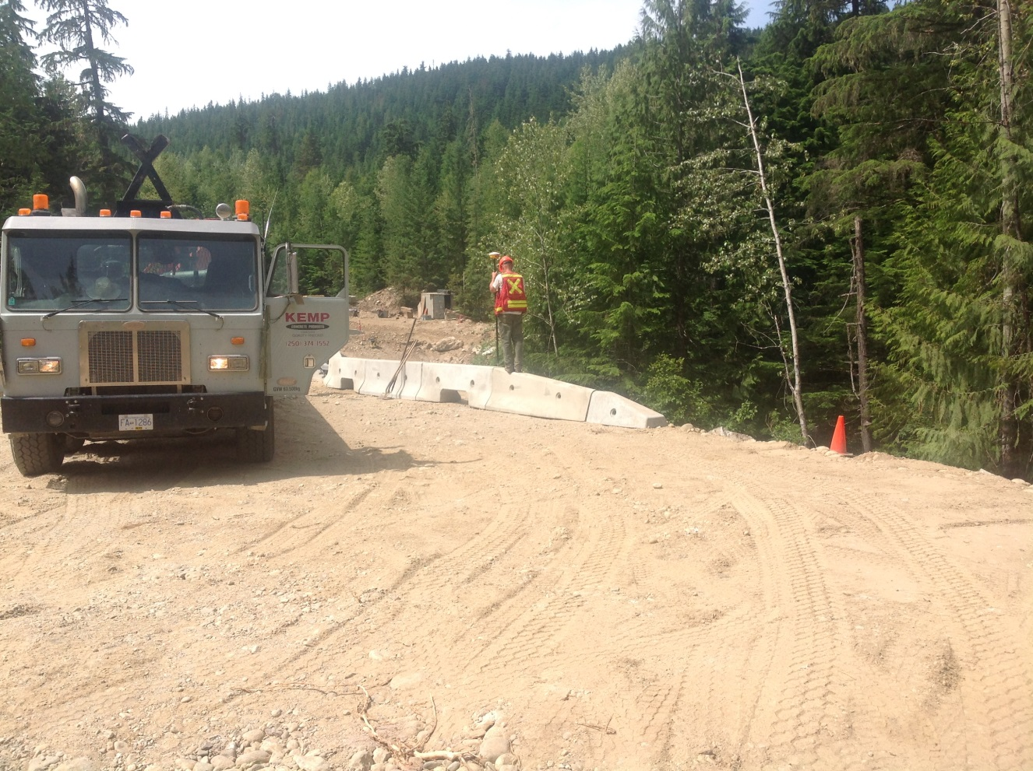
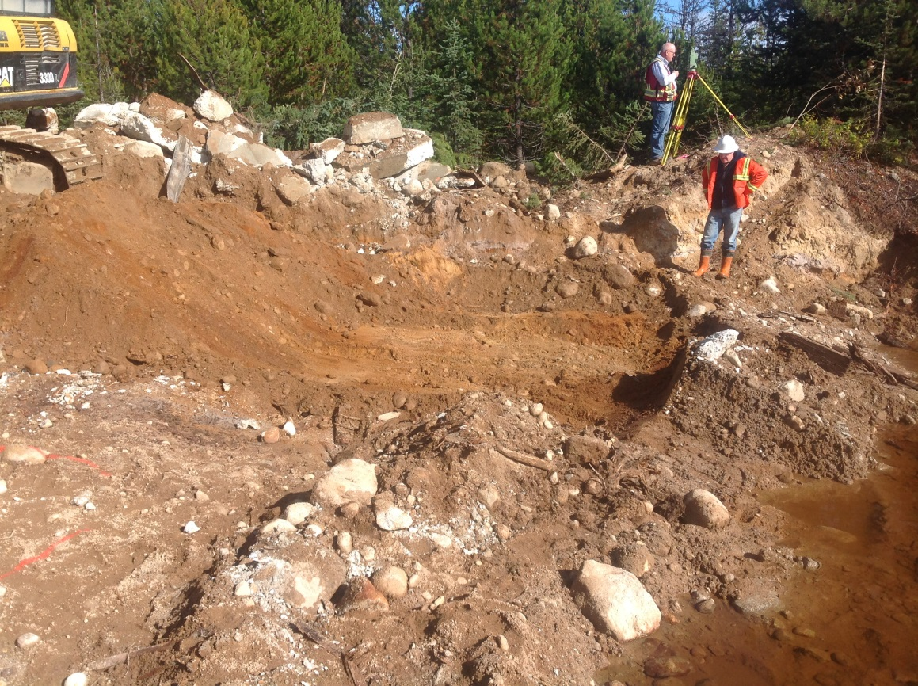
Experienced crew on layout required

Slide 10
Material Supply and Delivery
Verify road conditions
Ensure supplier is aware of road constraints
Verify delivery of all structure components
Verify condition of components delivered

Slide 11
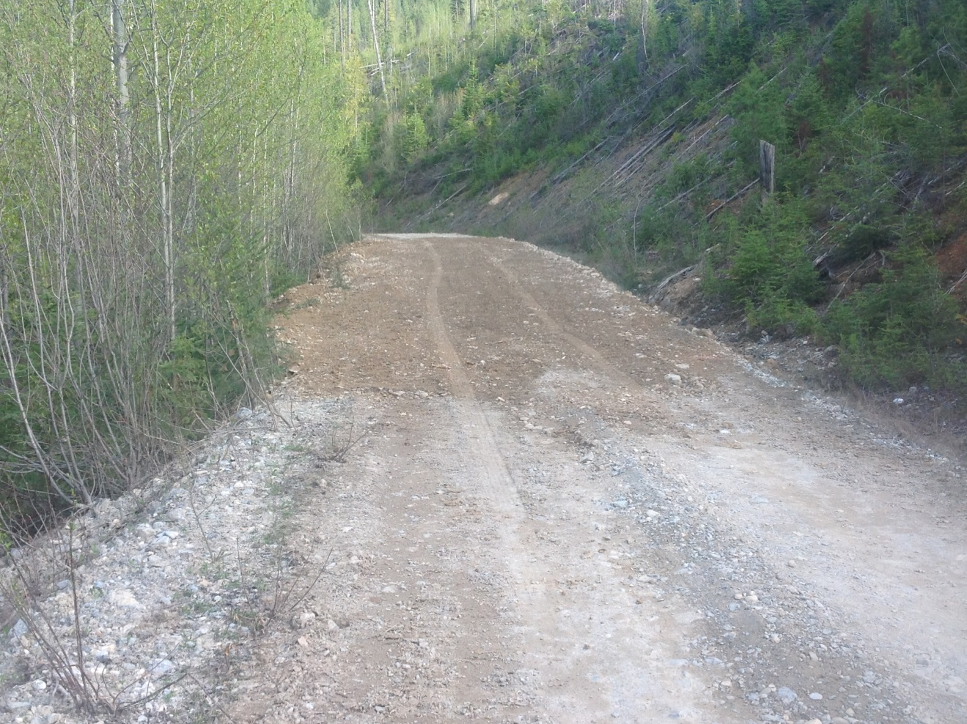
Road conditions may need to be addressed prior to structure delivery
Notes:
Road had soft spots and tight corners identified ahead of time so that they could be dealt with prior to structure hauled in to site.

Slide 12
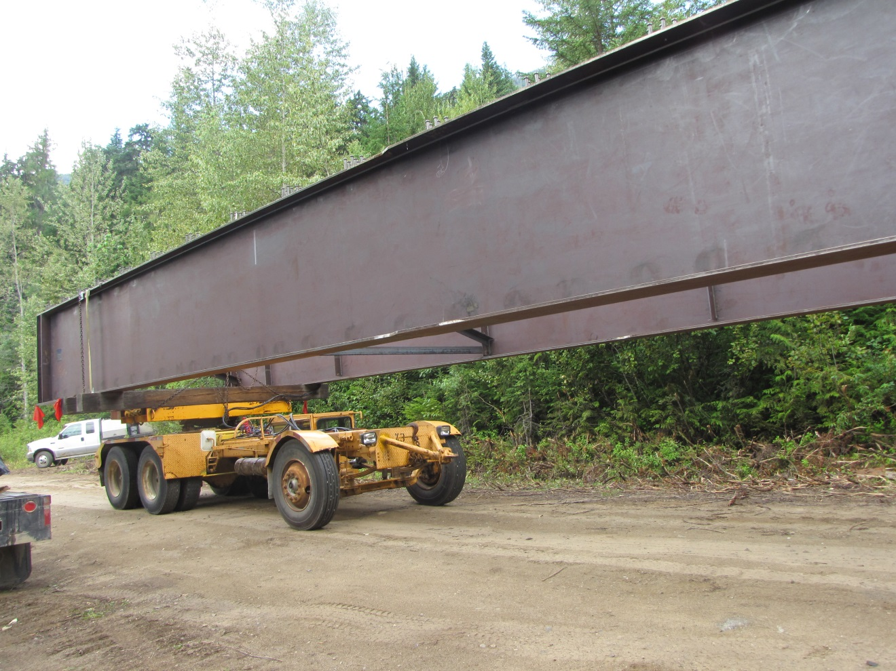
Identify road conditions to site adequately so that proper accommodations made to deliver structure to site
Notes:
Supplier was made aware of road condition limitations so in discussion with contractor a driving dolly was used to get the structure into site.

Slide 13
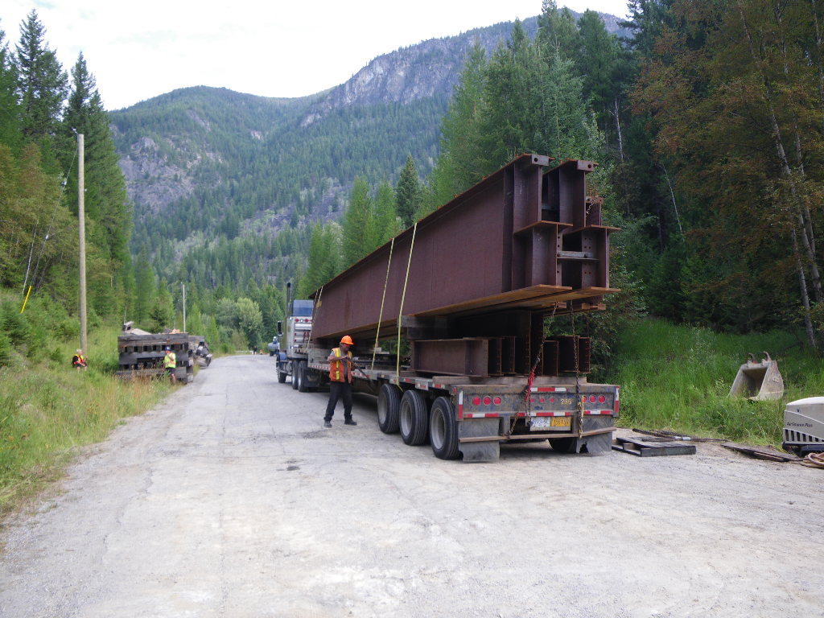
Many issues in the past with inadequate trucks and/or drivers delivering to site. As well, trucks not loaded correctly.
Notes:
Load shifted enroute to site. Took crew half a day to secure the load safely and unload.

Slide 14
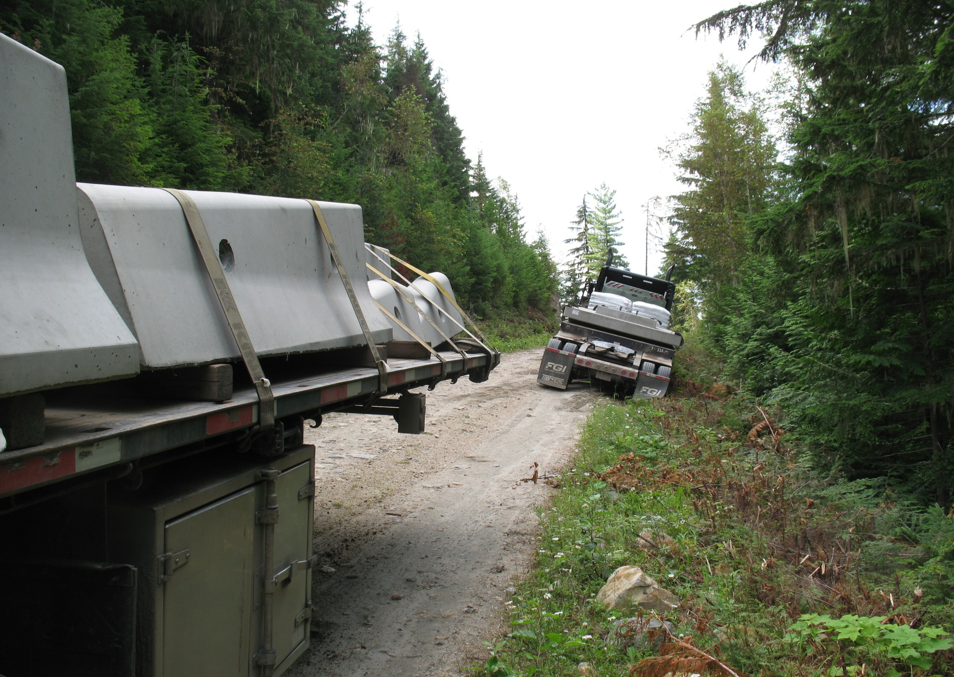
Notes:
Directions to drop a trailer at bottom of road system was ignored. Driver became worried and drop the trailer part way in on a steep grade. When started up again truck bounced over to bank and could not recover.

Slide 15
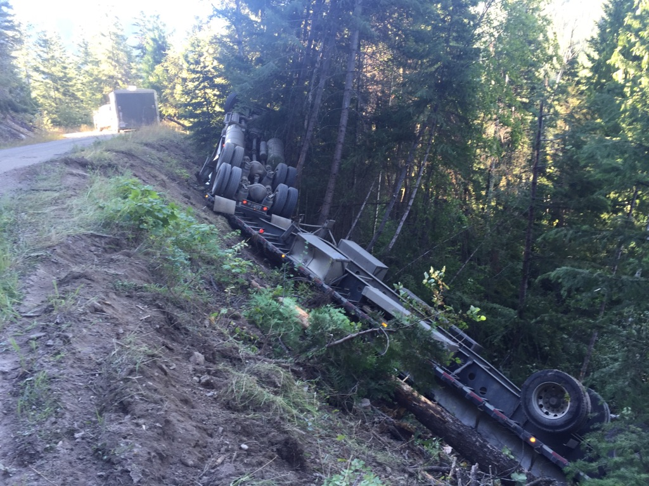
Notes:
Truck did not negotiate road into site. Investigation by trucking company identified driver error. Extra work required to inspect, prescription and repairs for slab girders.

Slide 16
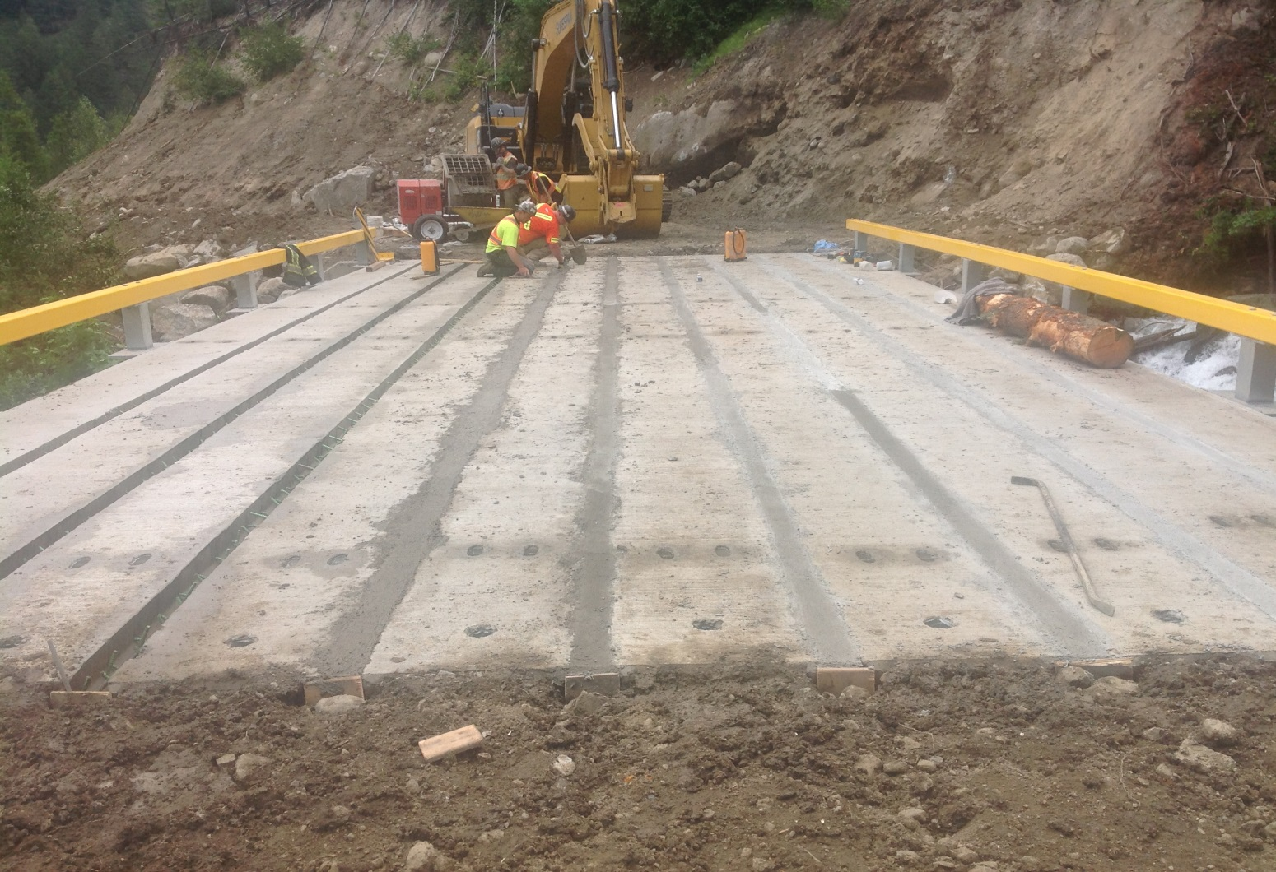
Verify that all bridge components arrive at site
Notes:
Not enough grout sent with bridge. Had to get more sent up by supplier.

Slide 17
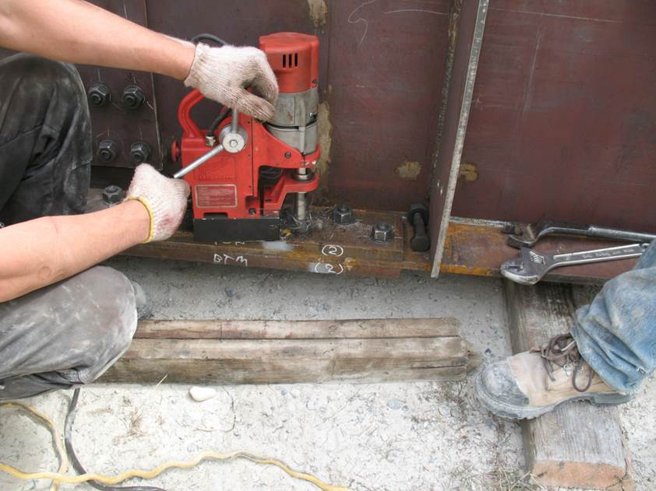
Look for manufacturing errors on supplies delivered to site
Notes:
Having to mag drill holes on site. Discuss structure where one post fell off on transport then was the wrong structure anyhow that was sent.

Slide 18
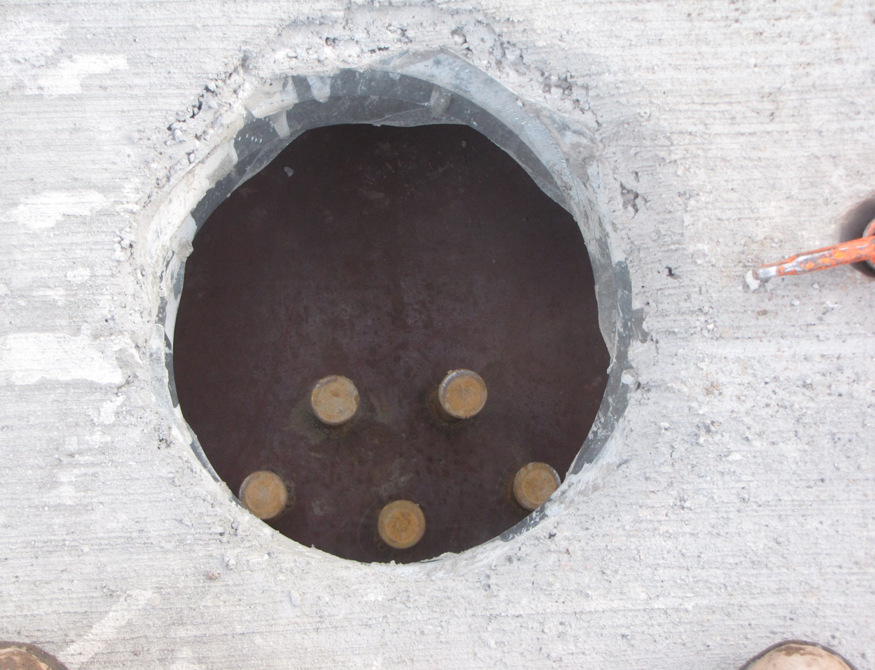
Notes:
One set of Nelson studs welded onto the wrong location on girder

Slide 19
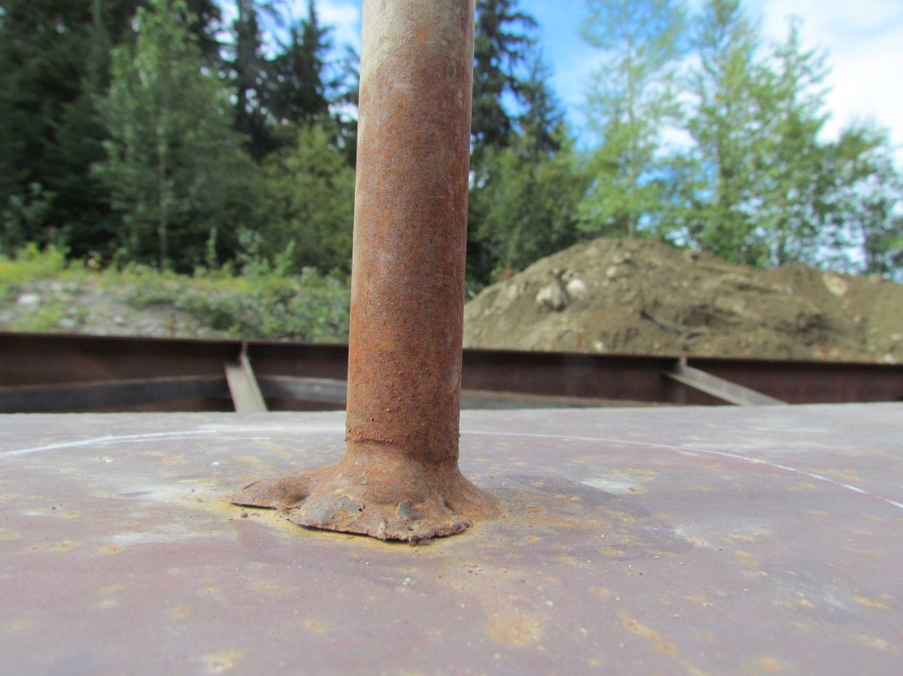
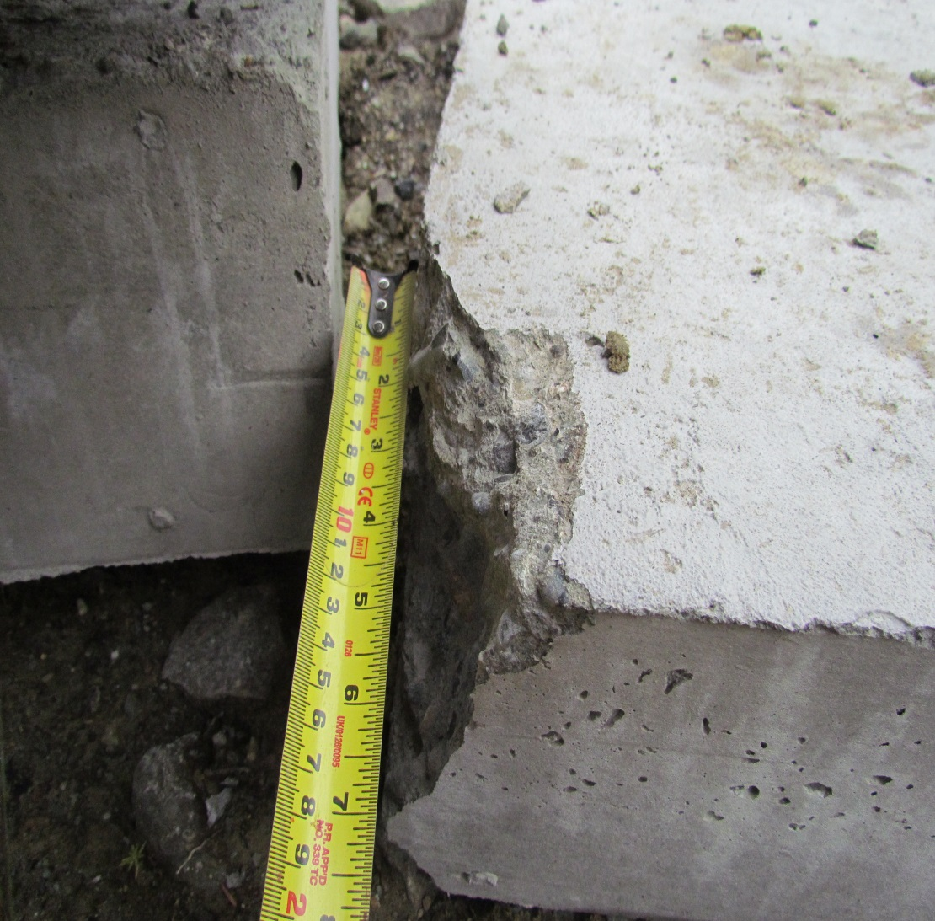
Notes:
This structure had many issues. Welding issues, honeycombed concrete, bolt on ballast wall with holes in wrong location, old can of bitumen paint sent.

Slide 20
Footings and Rip Rap
Placing footings at proper elevation
Ensuring proper compaction
Ensuring appropriate rip rap selection
Rip rap to be placed to proper depth
Rip rap to be placed to proper thickness

Slide 21
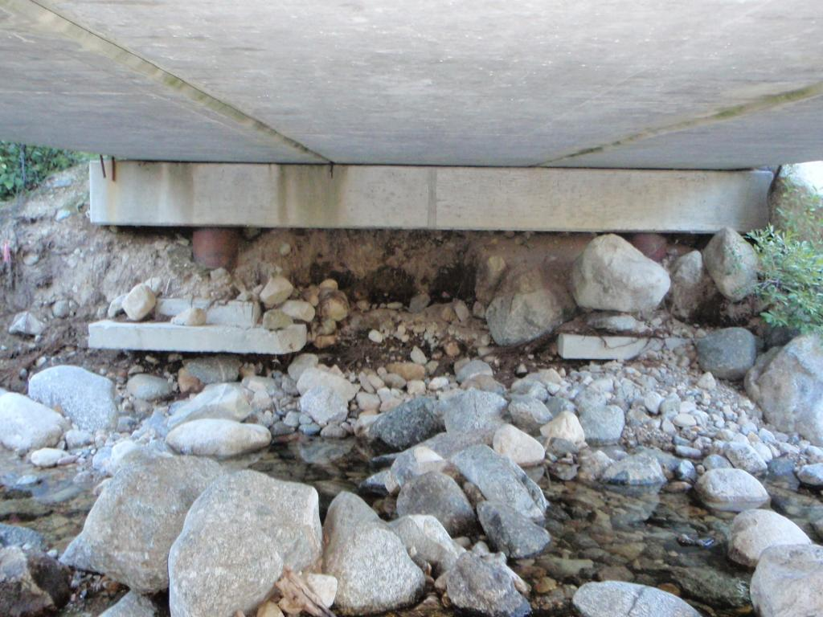
Problems can be encountered when footings are placed too high
Notes:
More risk for scour. As well, raising footing elevation may cause conflict with rip rap.

Slide 22
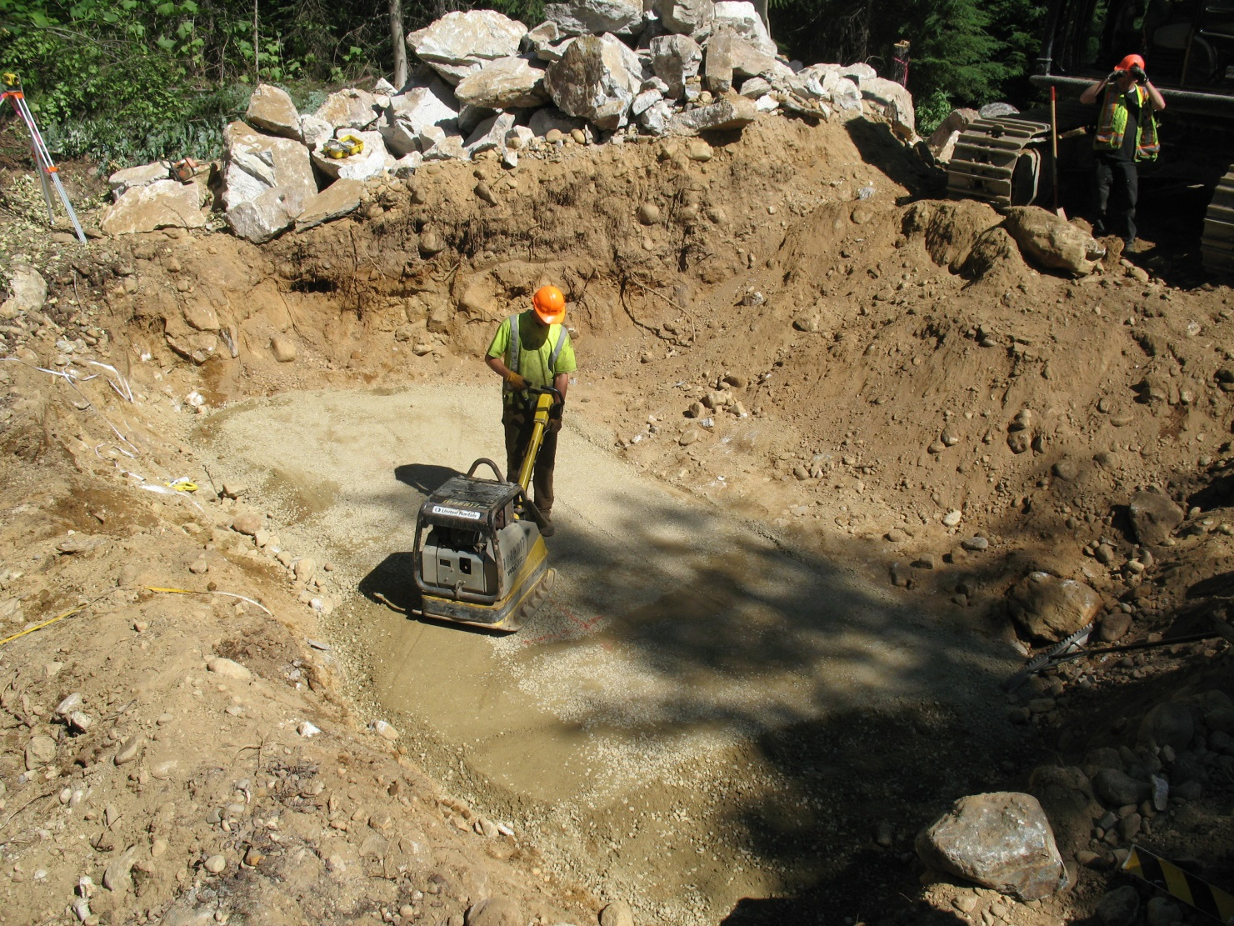
Proper compaction under the footings is necessary
Notes:
Our contracts require minimum equipment for compaction. Identify suitable material under footing as well. May require subexcavation and fill with rock to desired elevation if unsuitable material.

Slide 23
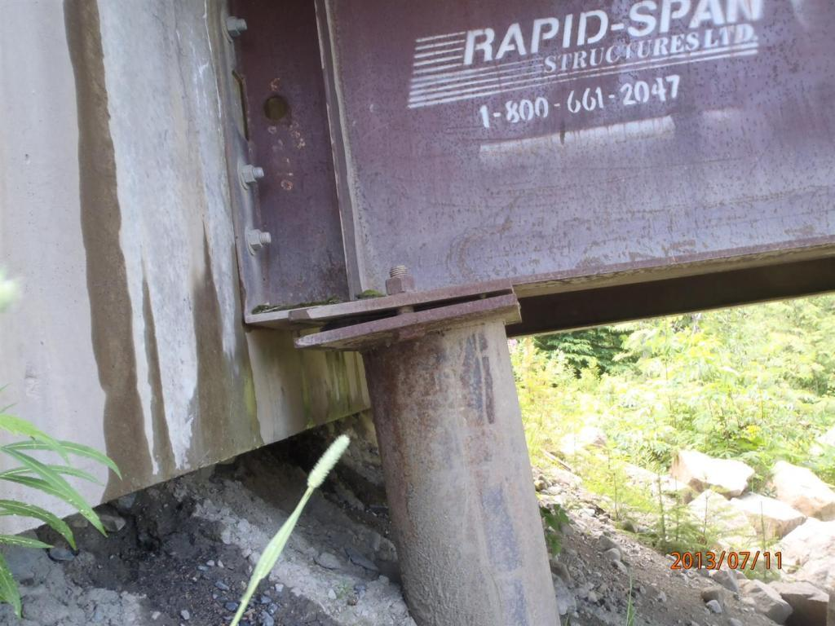
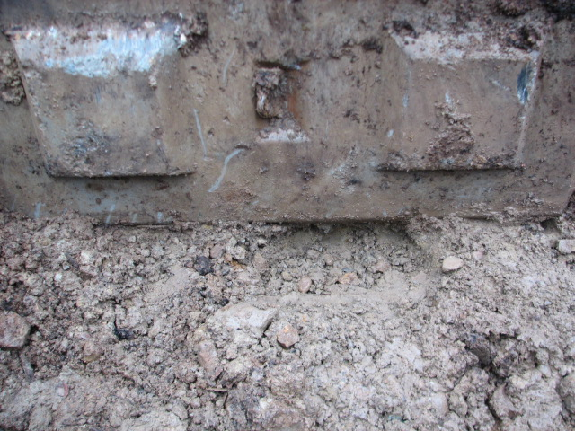
Poor footing compaction
Notes:
Contractor would have gone ahead with this if PoR had not come to site to inspect footing conditions

Slide 24
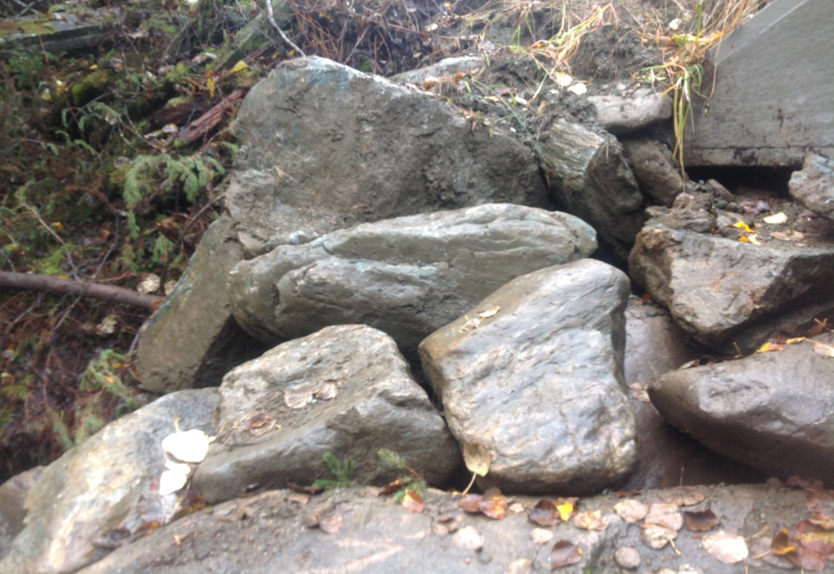
Improper rip rap selection
Notes:
Contractor did not want to blast rip rap. Collected rock from ditchline. Non angular and not right gradation. Need to ensure right size. Contractor may be bringing in too small of rip rap.

Slide 25
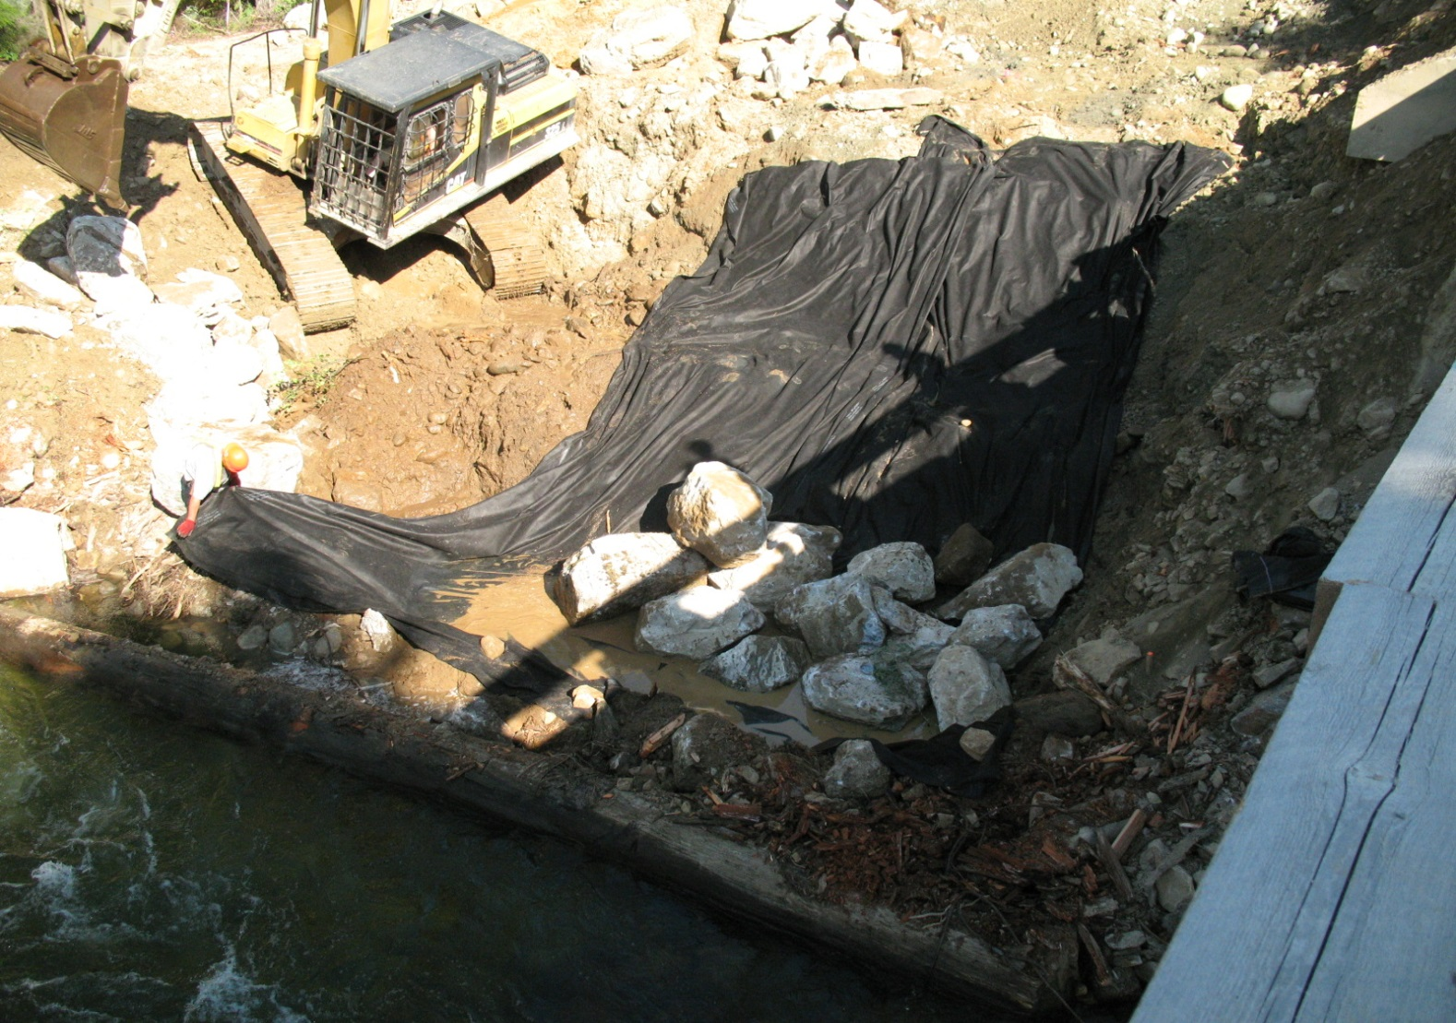
Rip rap to be keyed to the depth shown in GA drawings

Slide 26
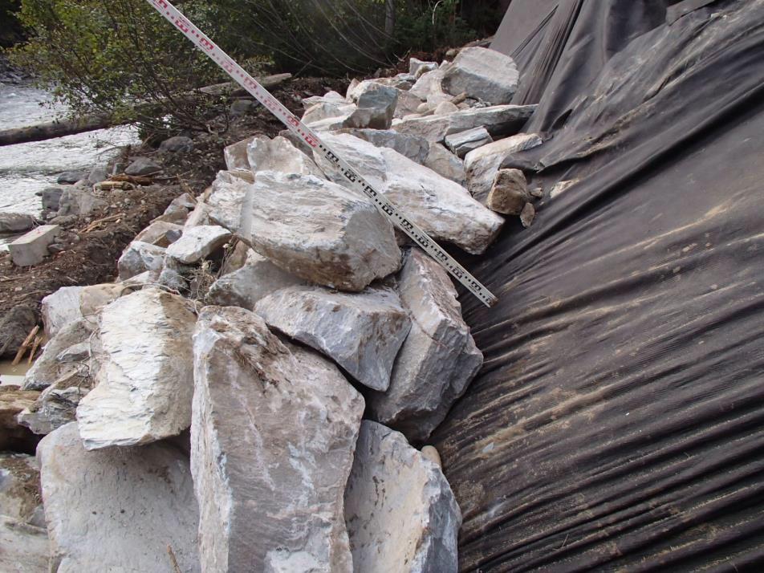
Ensure proper thickness of rip rap

Slide 27
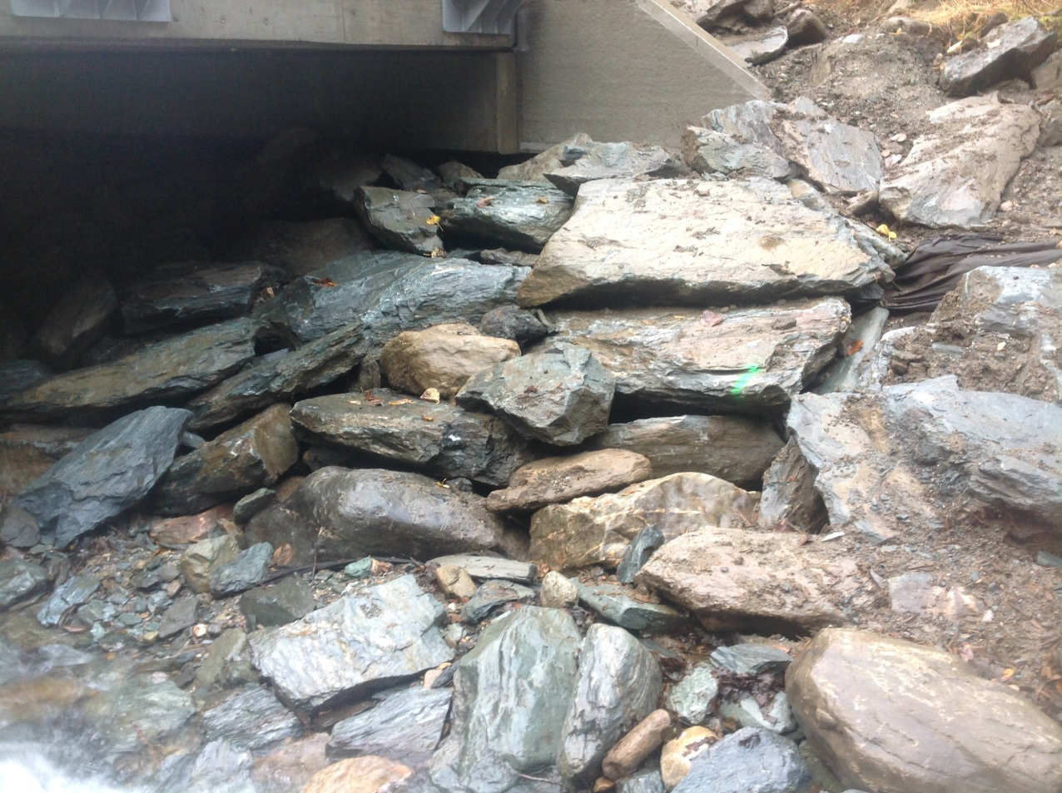
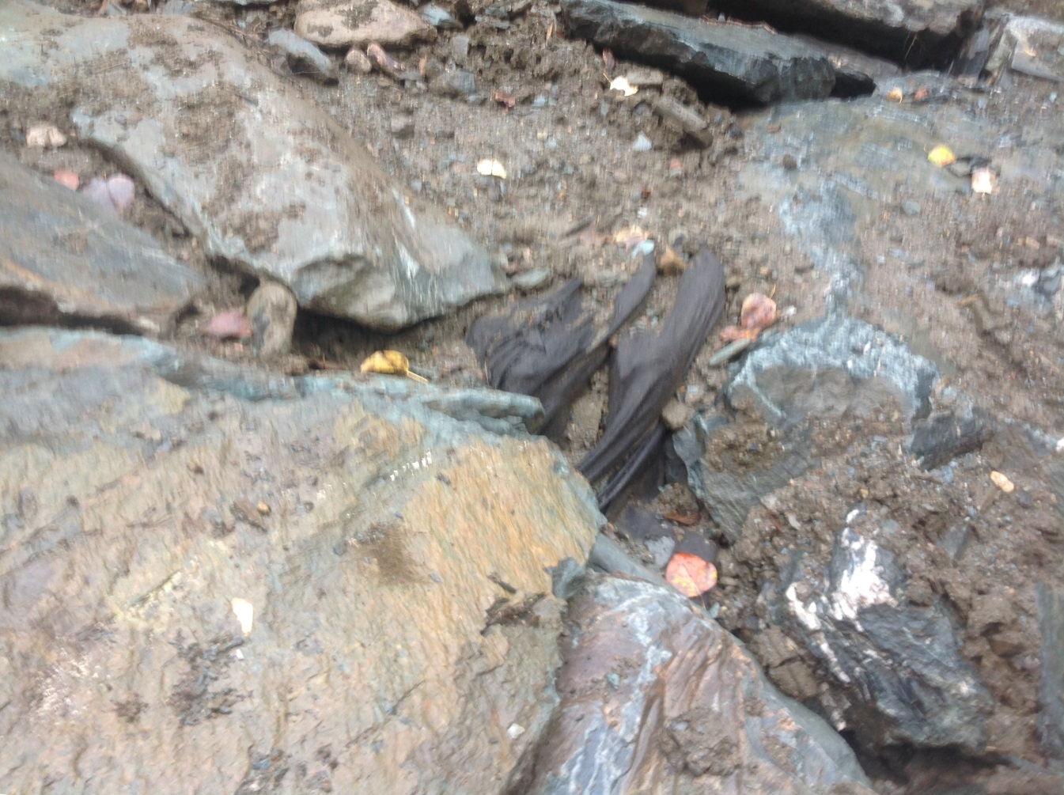
Rip rap not installed to depth or thickness
Notes:
Contractor convinced monitor to scrounge local rock so ended up short of rock required. Required thickness not attained. Not subexcavated to required depth as contractor did not bring pump and made case that water was getting into the excavation.

Slide 28
Girder Splice / Turn of Nut
Discuss Methodology with Contractor
Discuss Bolt Lengths and Amount of Turn
Identify Marking Procedure

Slide 29
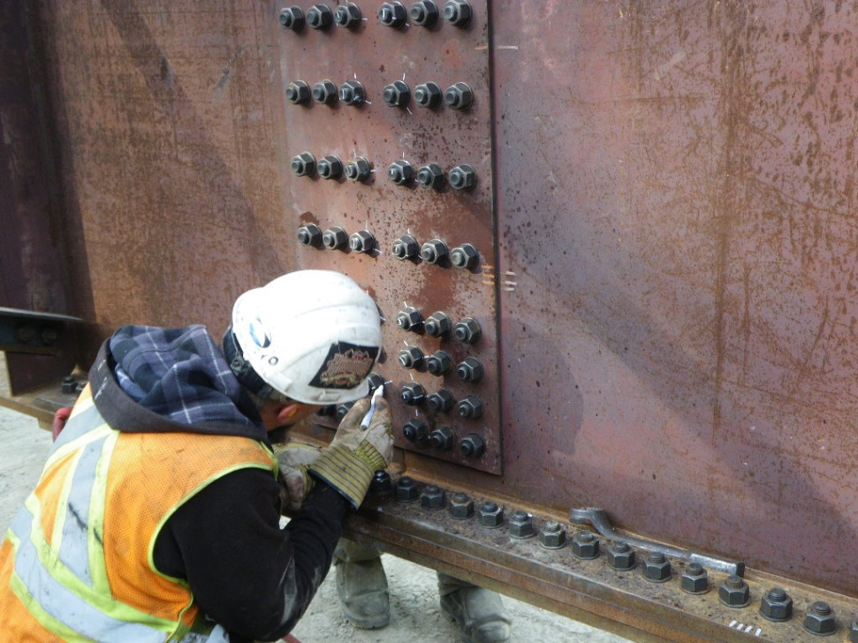
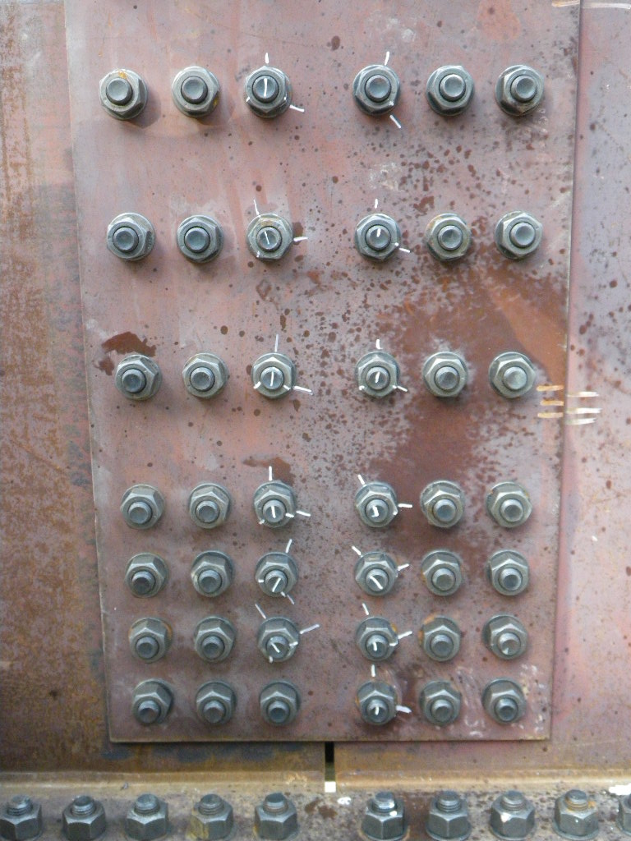
Proper Turn of Nut Methodology
Notes:
Snug tight then turn nut based upon criteria based on ratio of bolt length to diameter. May be different requirements between web bolts and the flange bolts.

Slide 30
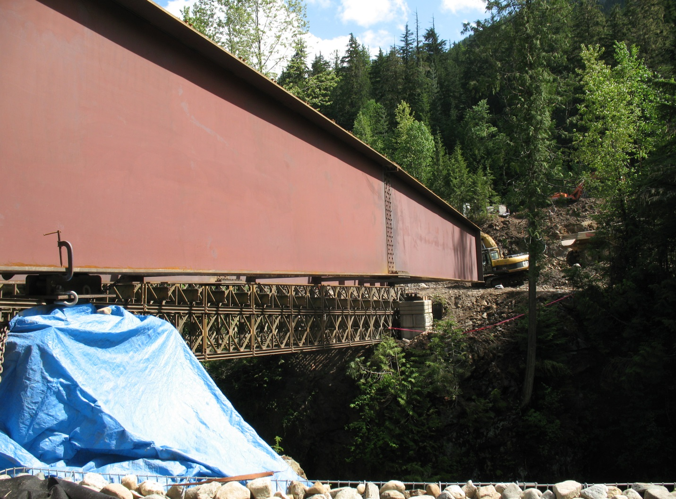
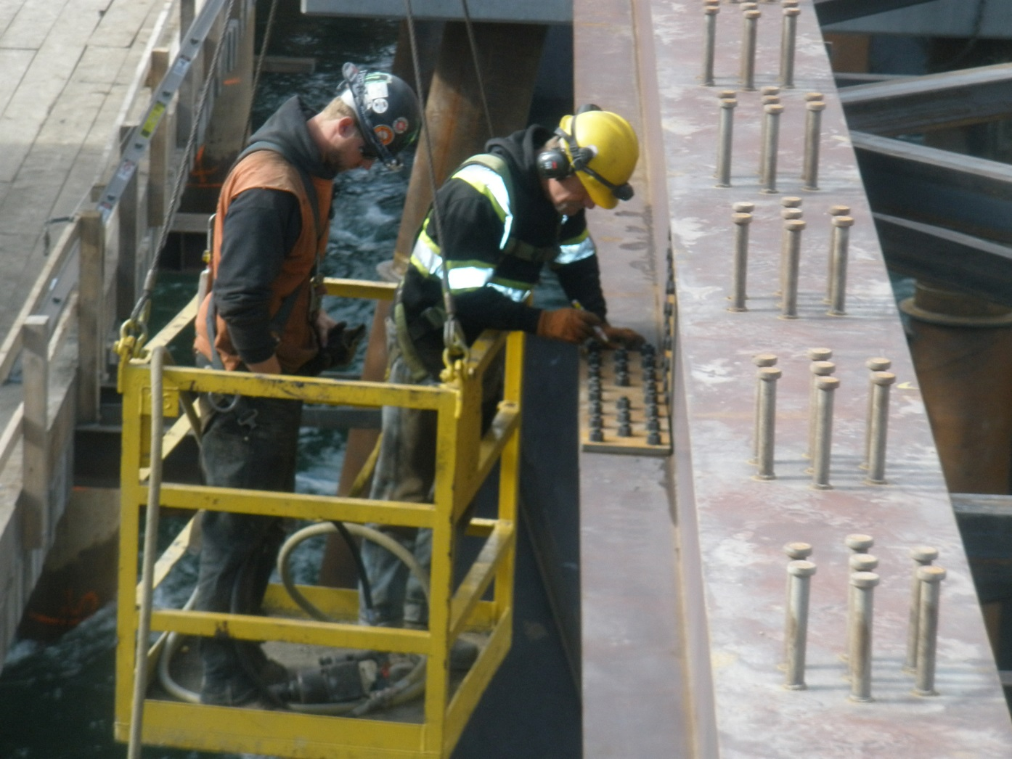
Can be expensive to rectify if done wrong
Notes:
Contractors did not account for change in bolt length to diameter ratio for the flanges. Instead of 1/3 turn these were supposed to be ½ turn.

Slide 31
Specification Verification / Testing
Identify Parameters to be verfied and testing procedure to be used
  Grout sample testing
  Nuclear Densomiter for compaction
  Weld inspection
  PDA
Ensure testing requirements are adhered to
Have mechanism in place to deal with non compliance

Slide 32
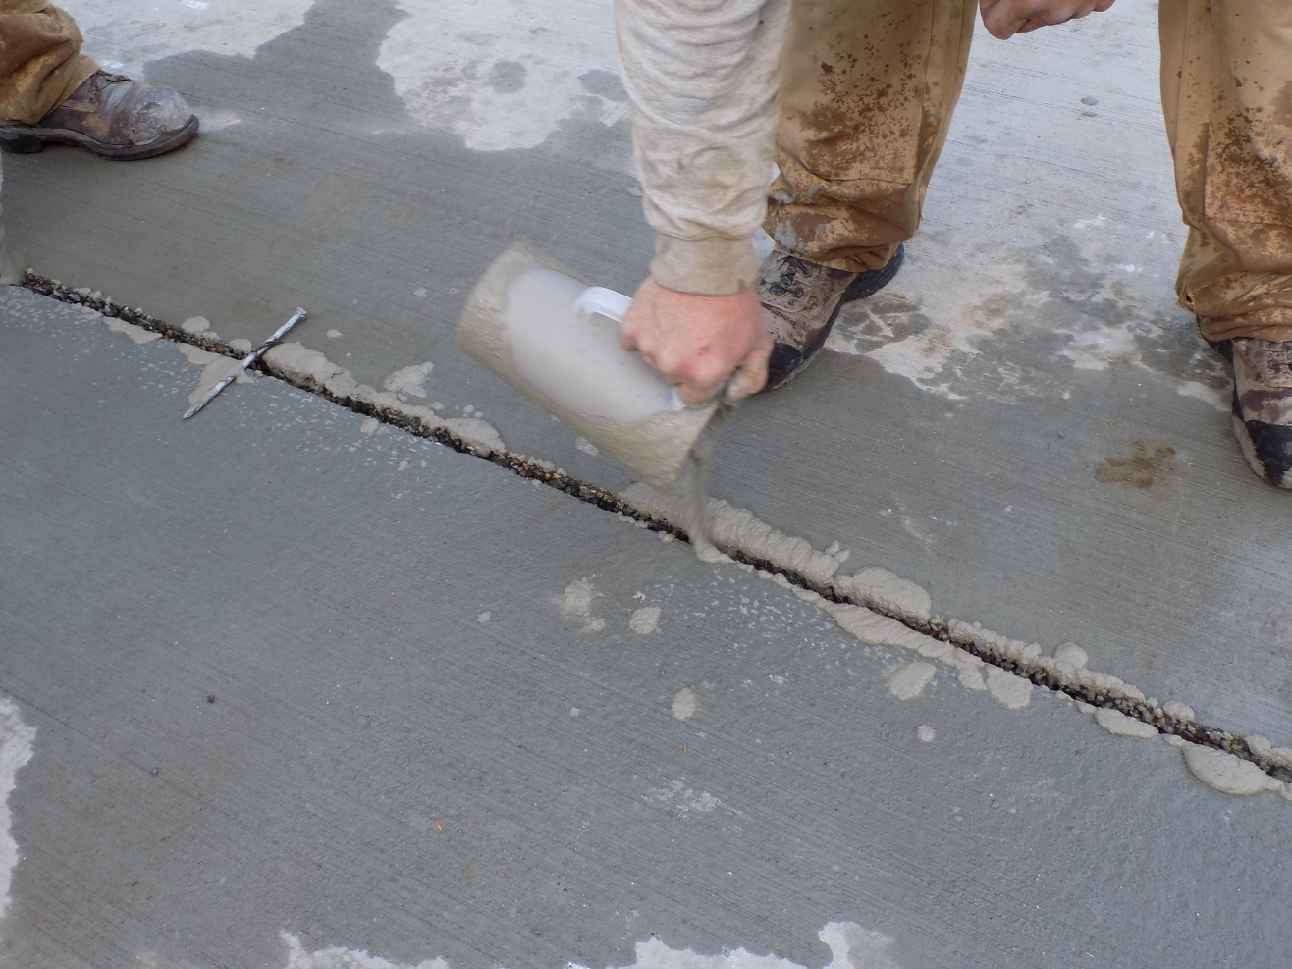
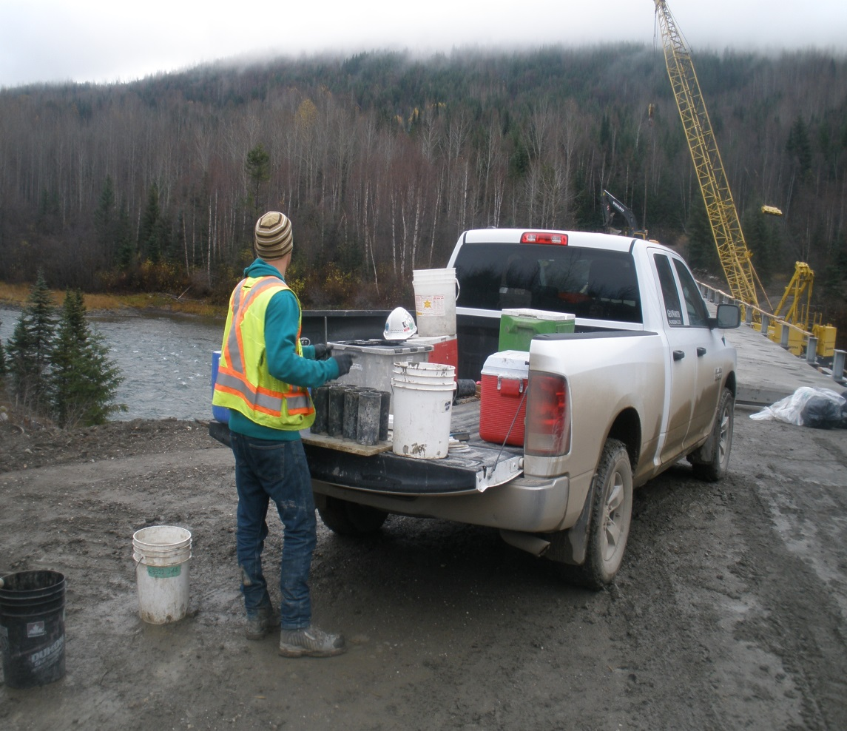
Grout Sampling
Notes:
Contractor may try and add too much water to grout as it is easier to work with. Our contracts require an independent third party to gather the samples and test the grout strength.

Slide 33
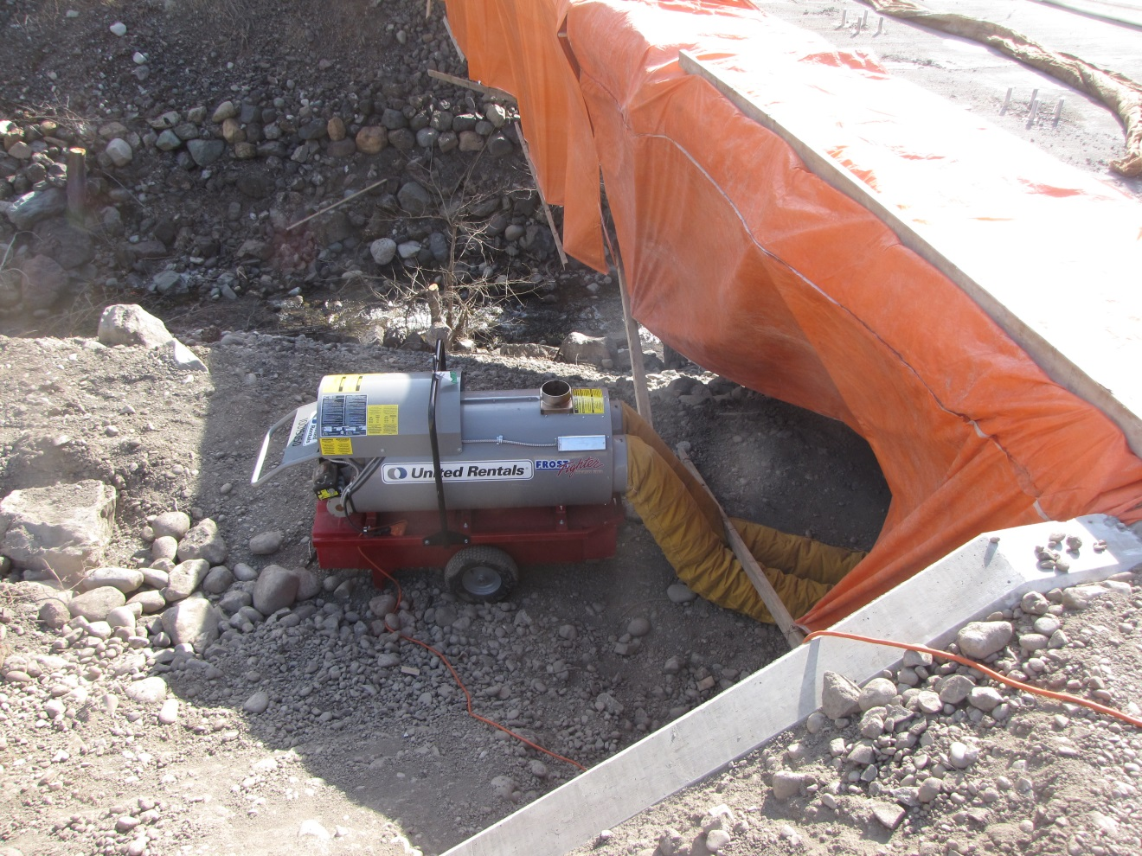
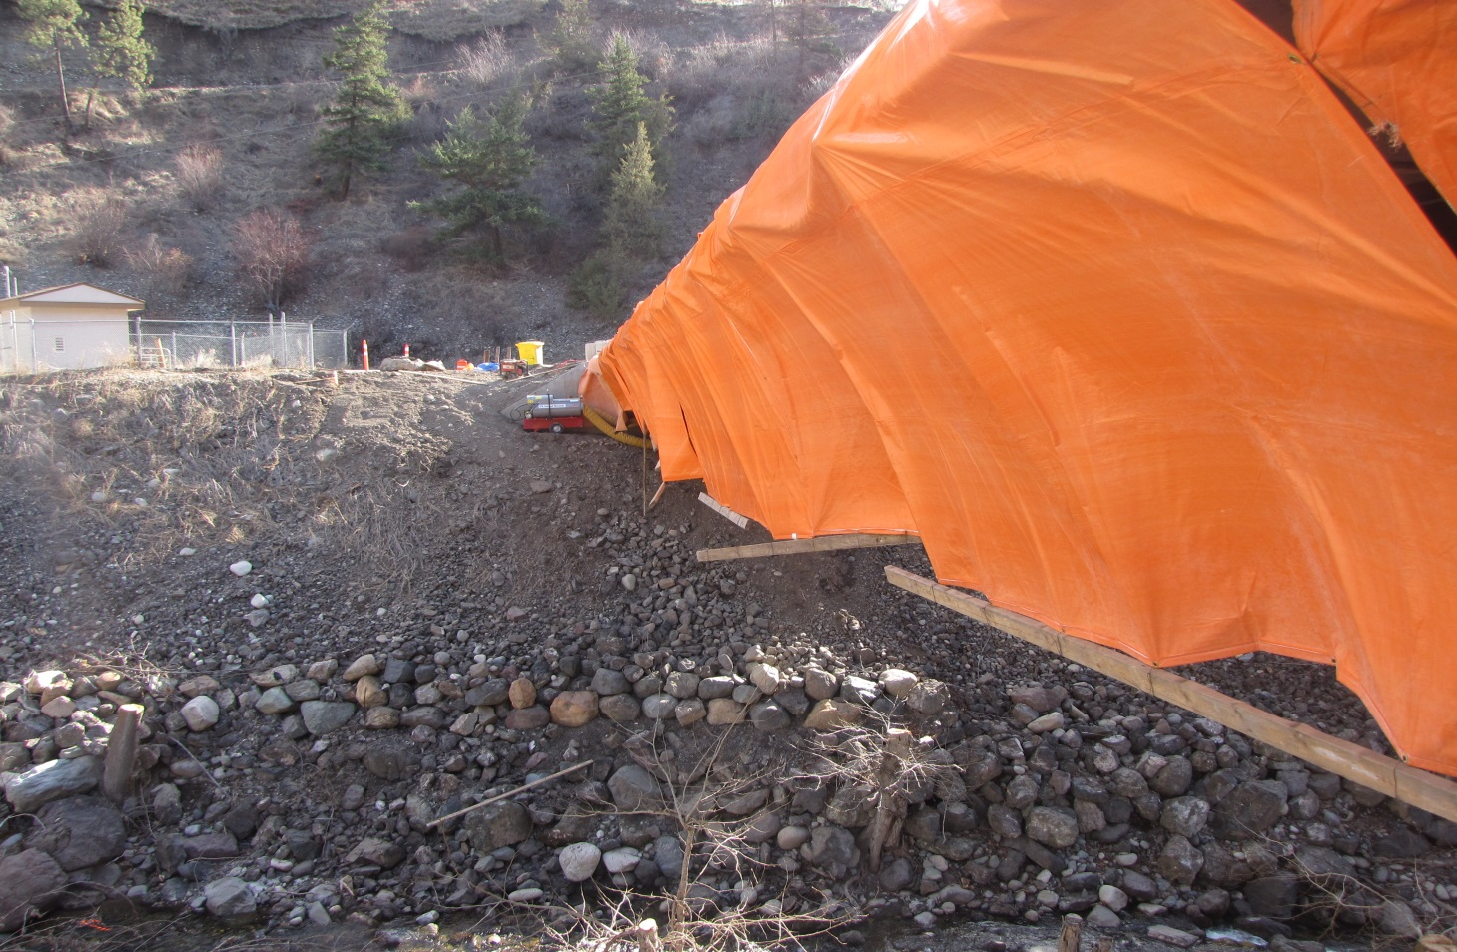
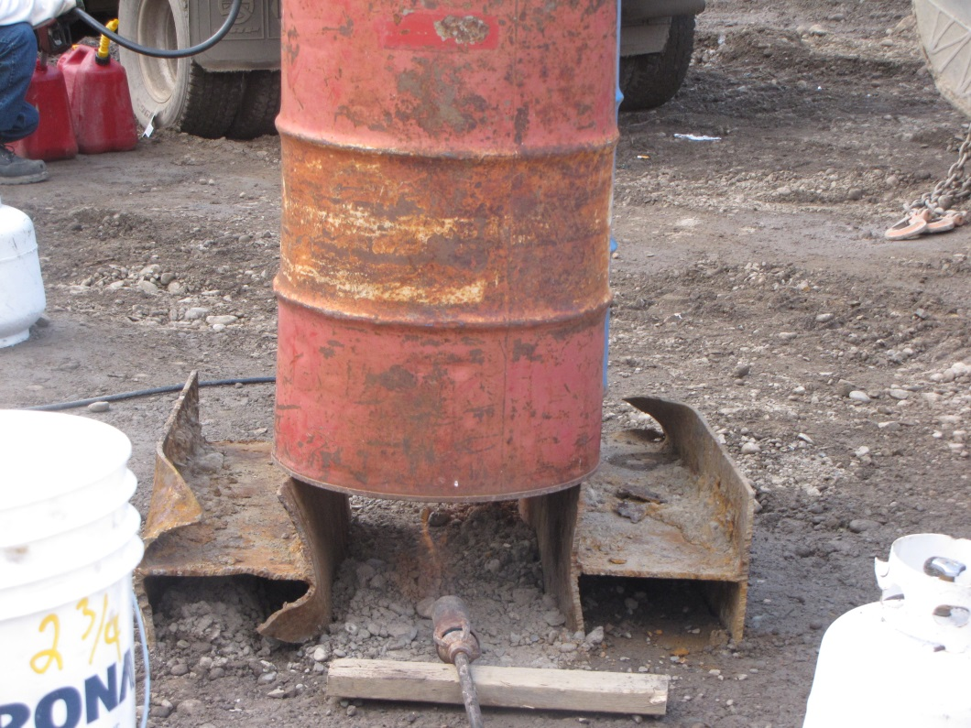
Weather conditions may affect grouting requirements
Notes:
Cold weather grouting procedures may need to be followed. Heat the structure prior to grouting. Heating of the water required. Hoard the bridge and heat for the overnight period.

Slide 34
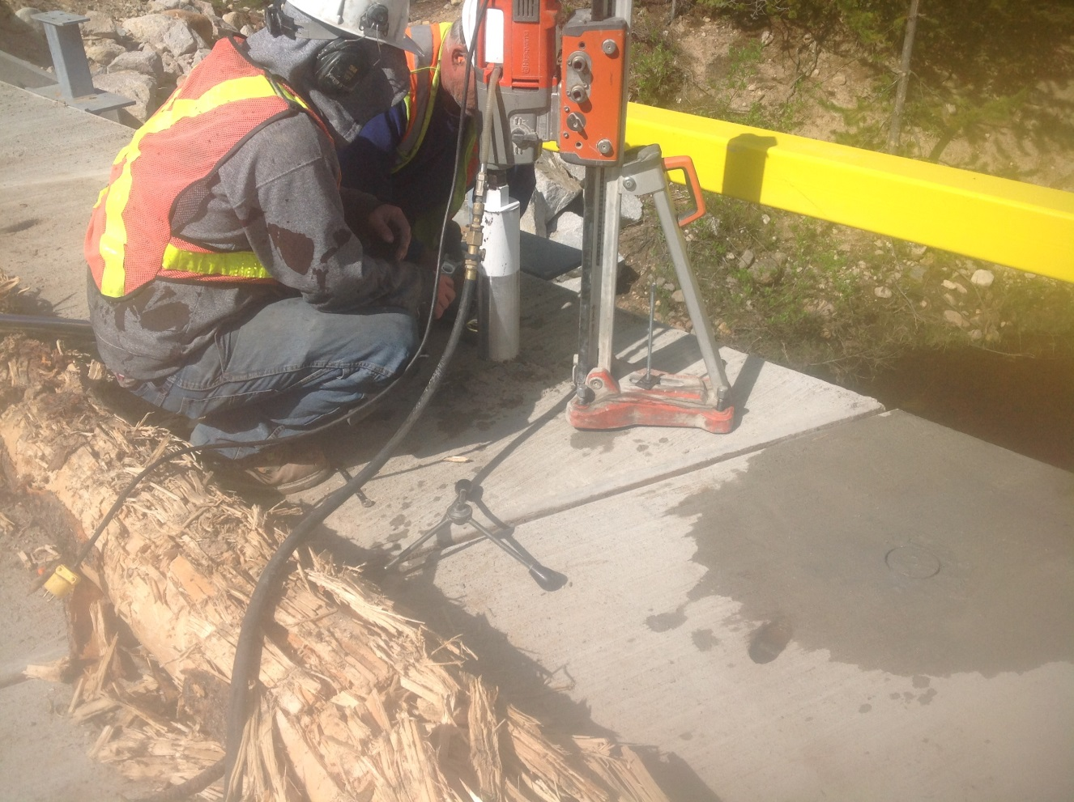
Additional measures may be required to gather samples if not taken properly
Notes:
Coring samples may be required or may be acceptable to use a Schmidt hammer to determine grout strength.

Slide 35
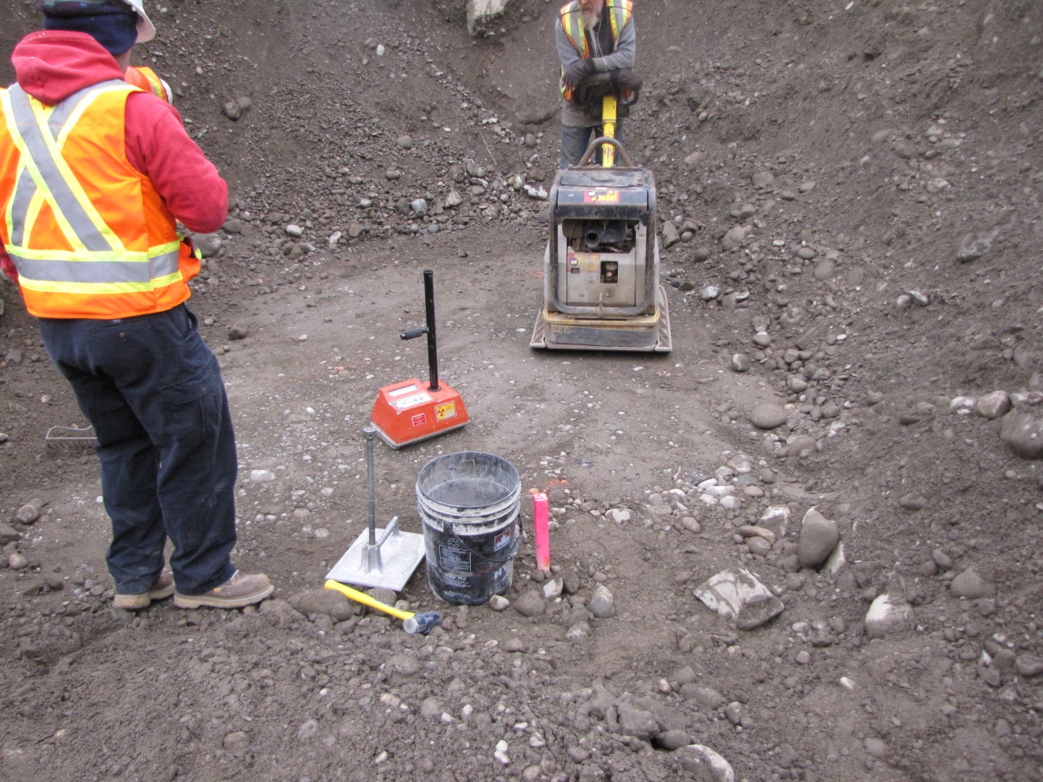
Nuclear densomiter testing done to verify compaction
Notes:
If doing compaction testing then need to gather soil sample to be tested to get proctor information prior.

Slide 36
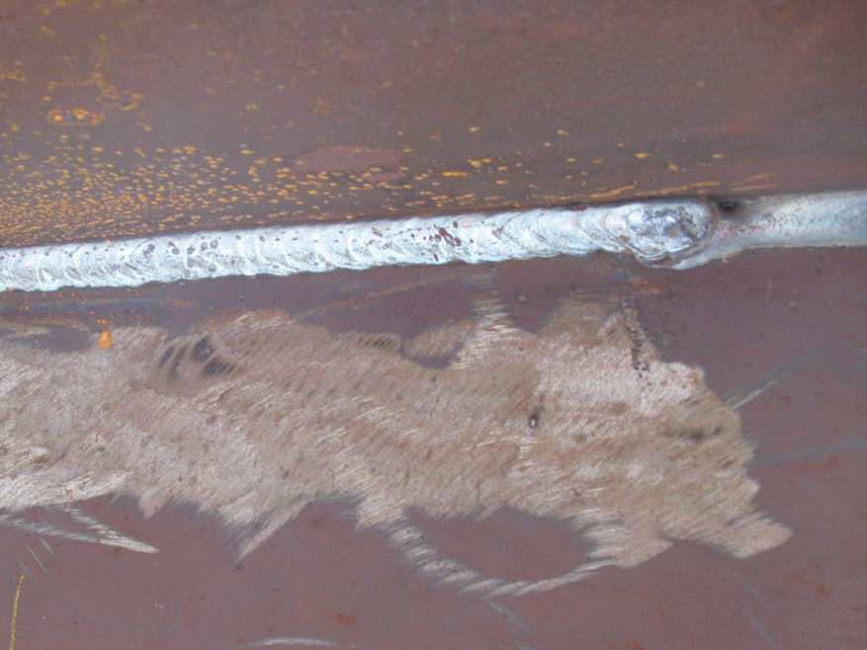
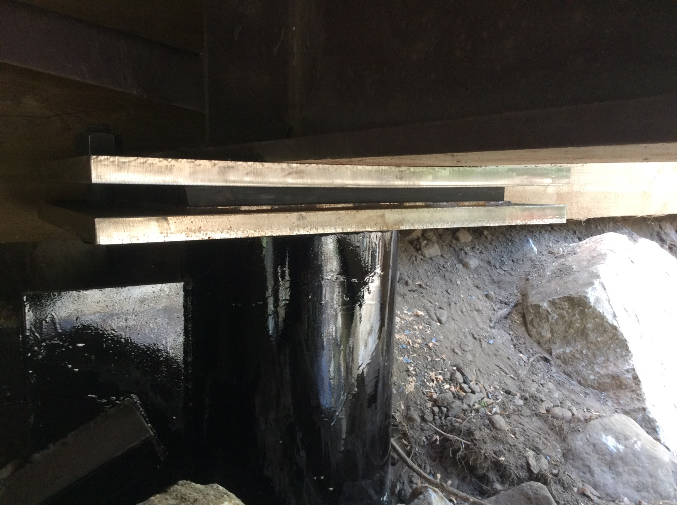
NDE weld inspections may be warranted
Notes:
Examples of welding errors. NDE (non destructive examination) testing may include visual, mag particle, liquid penetration, ultrasound. Bearing plate welded to top of pile with too big of a fillet and not enough heat sink so warped plate.

Slide 37
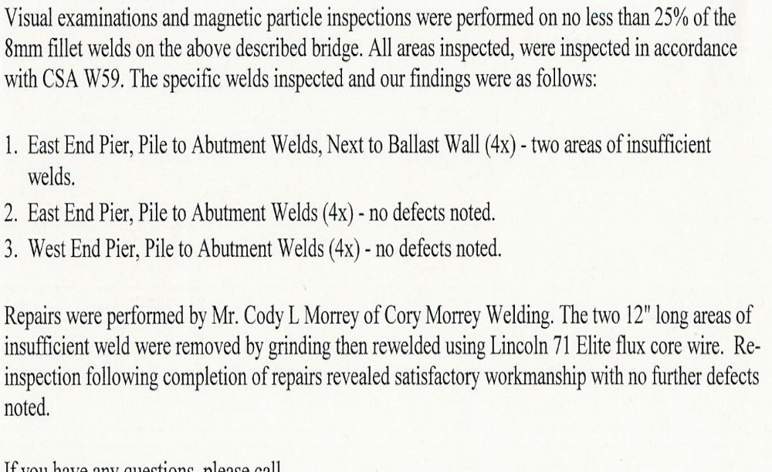
Example Weld Inspection
Report

Slide 38
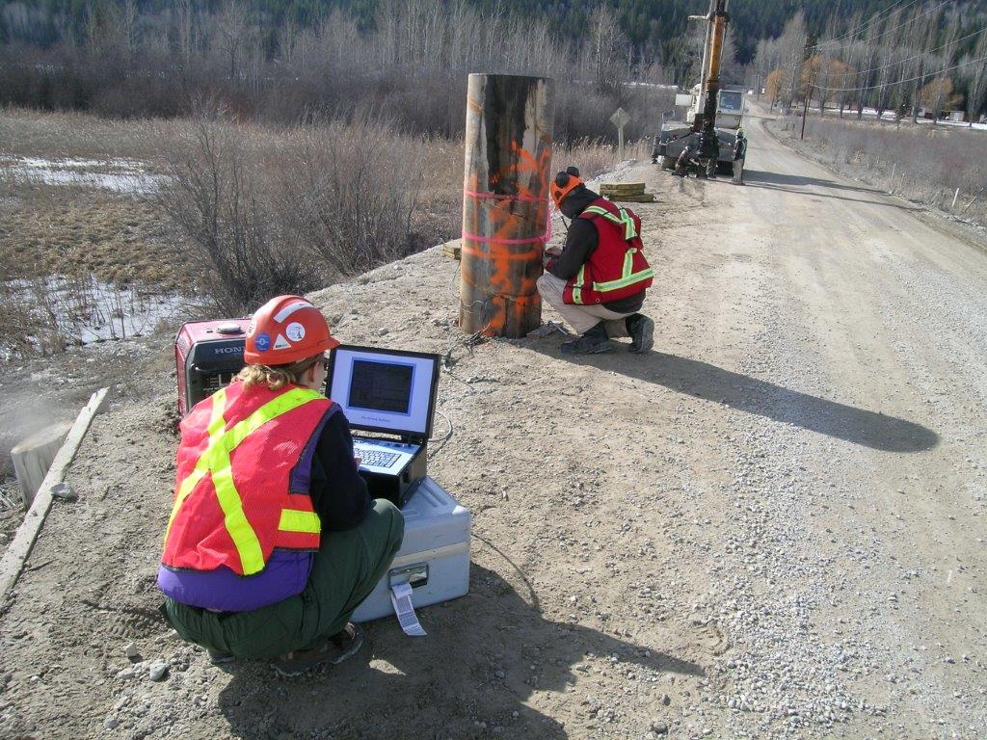
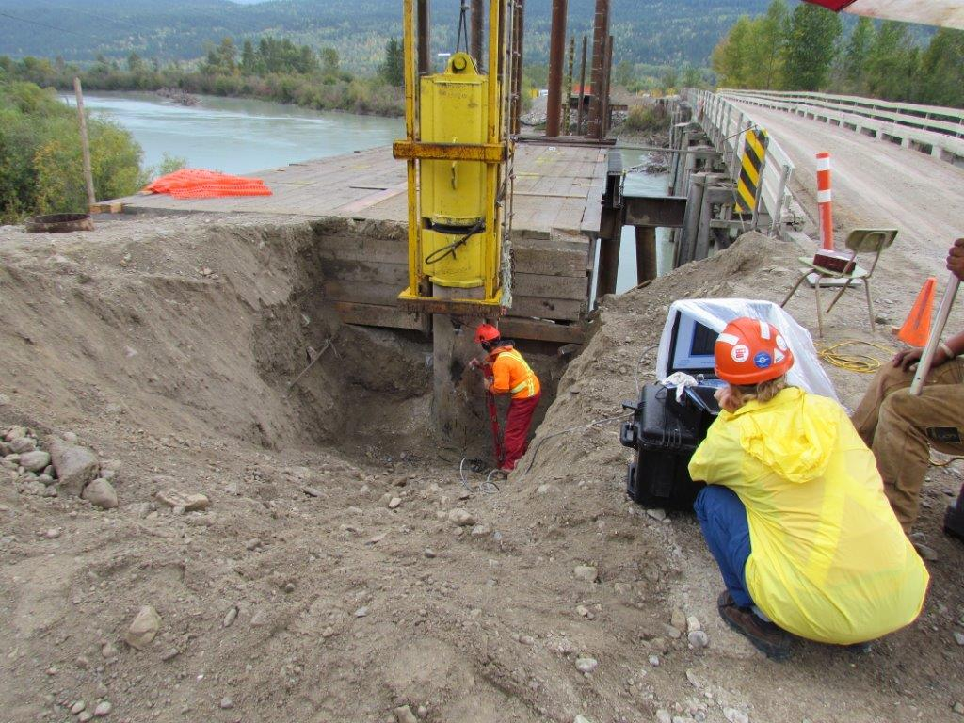
Pile driving may require PDA testing
Notes:
If driving refusal is not met PDA (pile driving analyzer) testing may be needed to verify capacity. Have wording in contract to accommodate this possibility.

Slide 39
Inspection / Monitoring/ Professional of Record
Contract inspections should be conducted to a level appropriate to the complexity of the structure being installed
Use of contract monitors may be beneficial to ensure that structures are installed correctly
Ensure contract monitors have sufficient experience on bridge installation
Give contract monitors clear direction on responsibilities and reporting requirements
Professional of Record (PoR) required for bridge installation sign off
PoR can be supplied by the Ministry or included as a requirement of the bridge installation contractor
Ensure clear direction on key phases expected to be reviewed by PoR

Slide 40
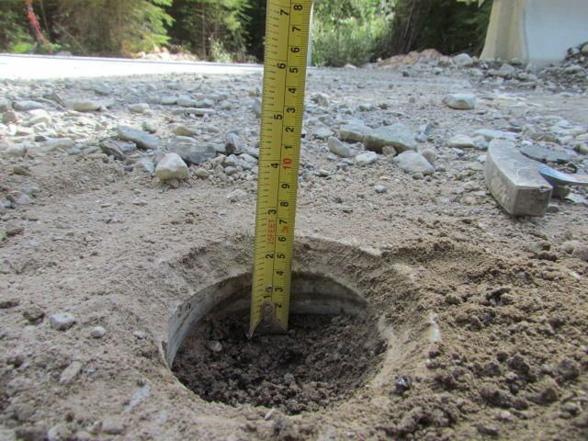
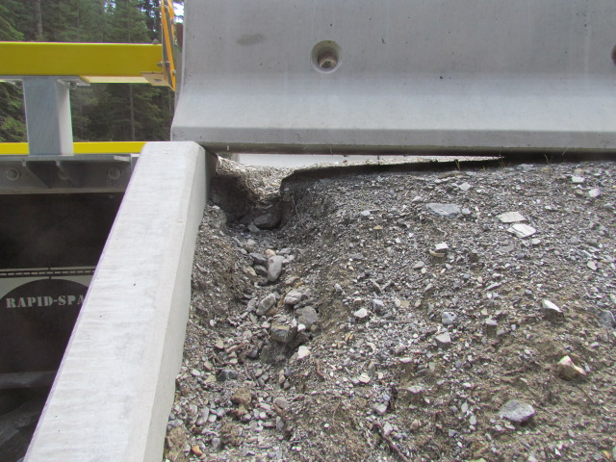
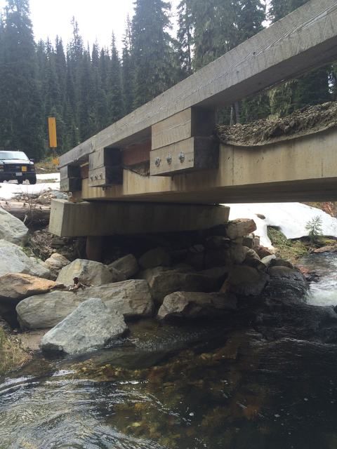
Inadequate review of structure installation may result in deficiencies to structure in the future
Notes:
Not enough oversight on the install can lead to problems

Slide 41
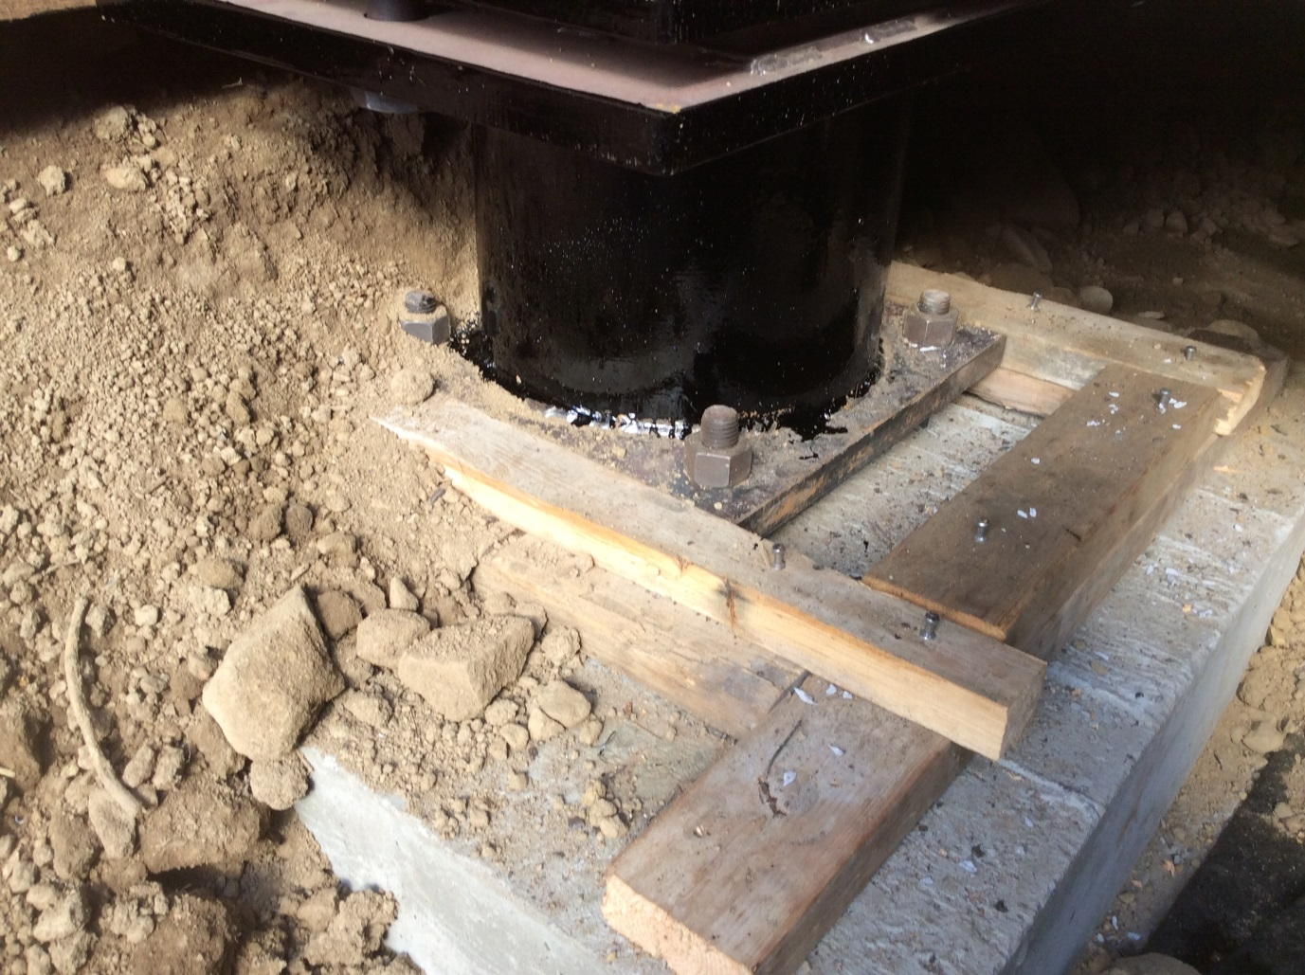
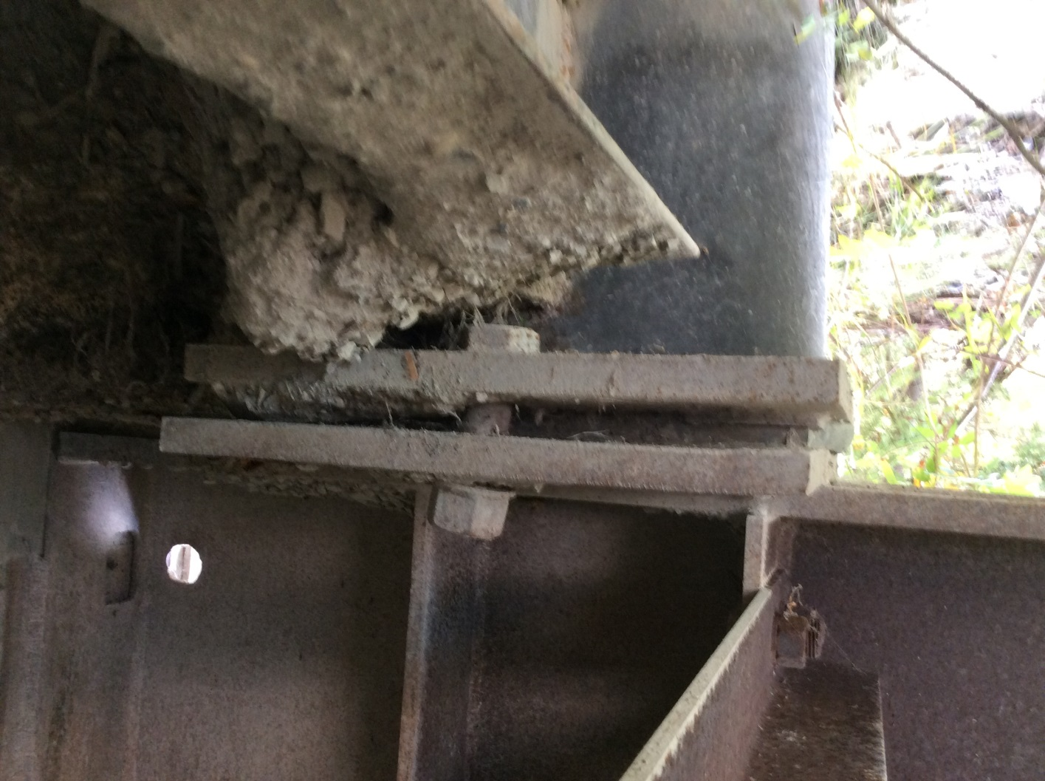
Notes:
Examples of problems that can occur with not enough oversight. Grout not put under tower. One side of structure backfilled and compacted with nothing on the other side. Uneven forces on the structure.

